Slide 1
Save Money and Reduce Trash (SMART) Benefits Analysis
Prepared for the
Northeastern Connecticut Council of Governments (NECCOG)
October 2019

Slide 2
Today’s Presentation
1 | Why Should Connecticut Reduce Its Waste?
2 | How Could Connecticut Reduce Waste?
3 | Baseline Data
4 | SMART Benefits Analysis
5 | Discussion and Next Steps

Slide 3
Today’s Presentation
1 | Why Should Connecticut Reduce its Waste?
2 | How Could Connecticut Reduce Waste?
3 | Baseline Data
4 | SMART Benefits Analysis
5 | Discussion and Next Steps

Slide 4
Why Should Connecticut Reduce Waste?
Materials management is expensive ($100 million on residential disposal and recycling).
Capacity Shortfall (exporting 300,000+ tons out of state)
Aging MIRA Facility
Shrinking Northeast Capacity
Expensive WTE Disposal
Difficult Siting for New Facilities (landfills, incinerators)
Rising Disposal Costs
Rising Recycling Costs
Waste produces greenhouse gases.
Waste diversion creates jobs (36 -200+ for every 10,000 tons of trash diverted).

Slide 5
Today’s Presentation
1 | Why Should Connecticut Reduce its Waste?
2 | How Could Connecticut Reduce Waste?
3 | Baseline Data
4 | SMART Benefits Analysis
5 | Discussion and Next Steps

Slide 6
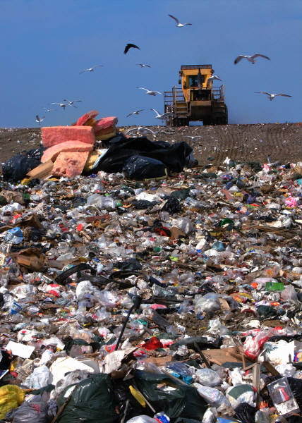
How Could Connecticut Reduce Waste?
The state has been actively encouraging waste reduction for 30 years or more. It has had some impact.
Bottle Bill (1980)
Computer, Paint and Mattress EPR
Education Campaigns (What’s In, What’s Out)
Aggressive Waste Reduction Goals
National Packaging Innovation (downgauging, light weighting)
National Recycling Campaigns
Single-Stream Recycling
Increased Consumer Access (curbside and drop-off recycling)
Other Programs (yard waste, event recycling days, etc.)
Education & Innovation
900 lbs.
per person / yr
740 lbs.
per person / yr
US Average, 1990
CT Average, 2019

Slide 7
How Could NECCOG Reduce Waste?
On the current trajectory, per capita waste should still drop some. This assumes that additional innovation, education, and other policies will hold back the expected increase in packaging waste from online shopping and convenient fast food/take out lifestyles.
Continued Education Campaigns
Better Recycling Technology
Expanded Bottle Bill
Packaging EPR
Waste Bans
Increased Single-Use Bans
Increased Access
Curbside Food Waste Collection
Continued Education & Innovation
900 lbs.
per person / yr
740 lbs.
per person / yr
590 lbs.
per person / yr
US Average, 1990
2020
2050

Slide 8
How Could NECCOG Reduce Waste?
Portland Maine along with 556 communities in New England throw away 40-60% less waste with SMART programs (there are no exceptions).
SMART
900 lbs.
per person / yr
740 lbs.
per person / yr
286 lbs.
per person / yr
US Average, 1990
2020
Portland, ME Today

Slide 9
How Could NECCOG Reduce Waste?
Curbside food waste collection—and other new program types—can reduce per capita waste even more.
SMART
Curbside Food Waste Collection
900 lbs.
per person / yr
740 lbs.
per person / yr
286 lbs.
per person / yr
150 lbs.
US Average, 1990
2020
Portland, ME Today
SMART w/Curbside Food Waste

Slide 10
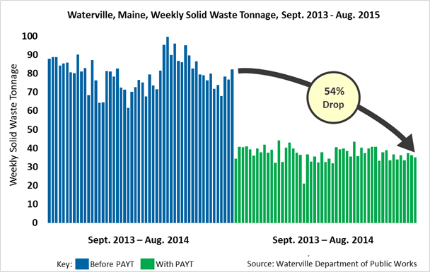
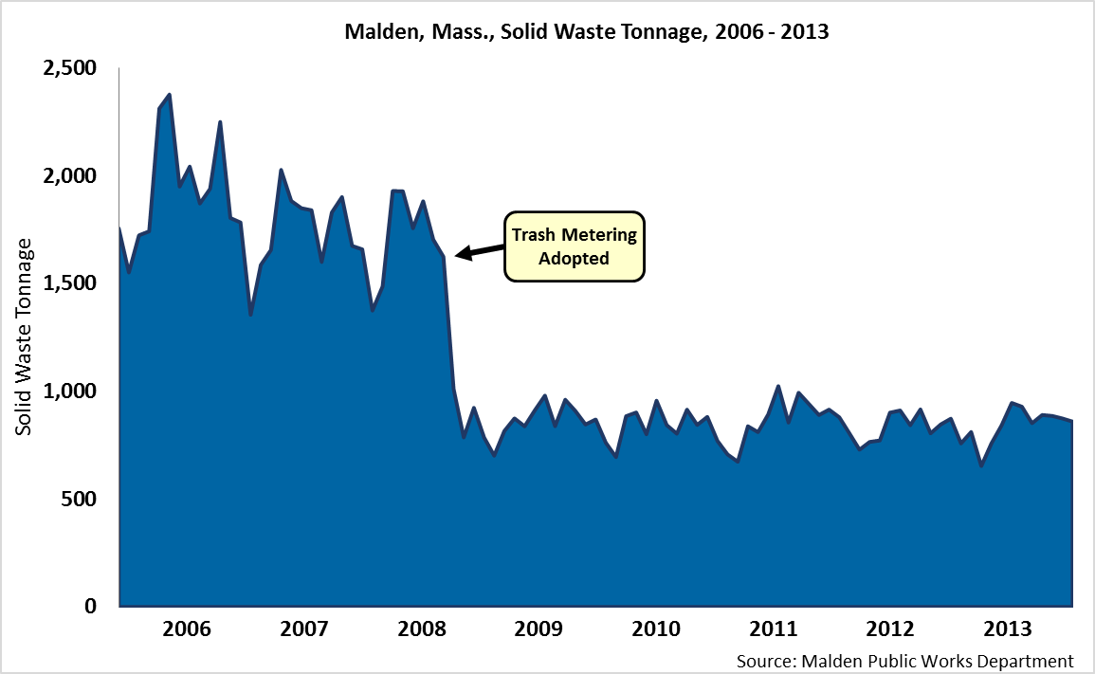
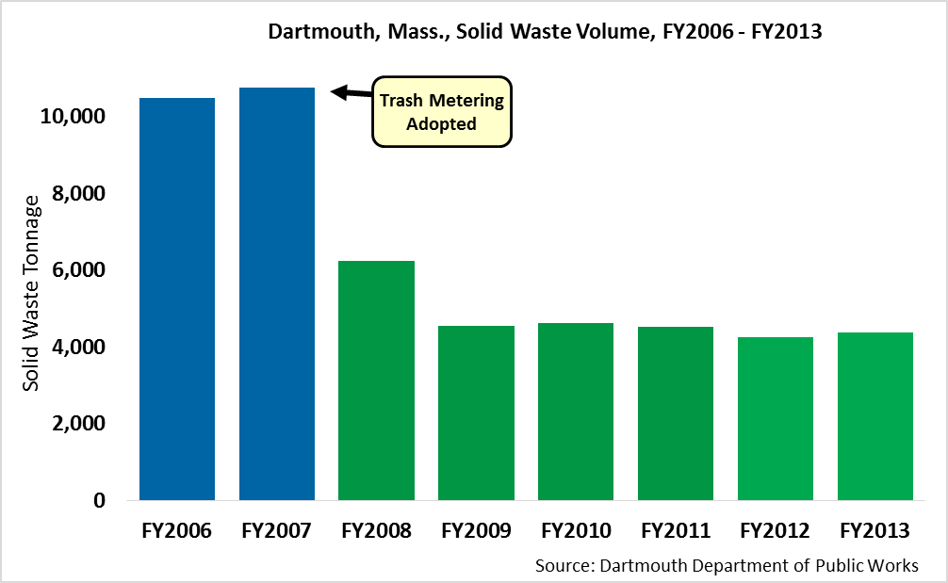
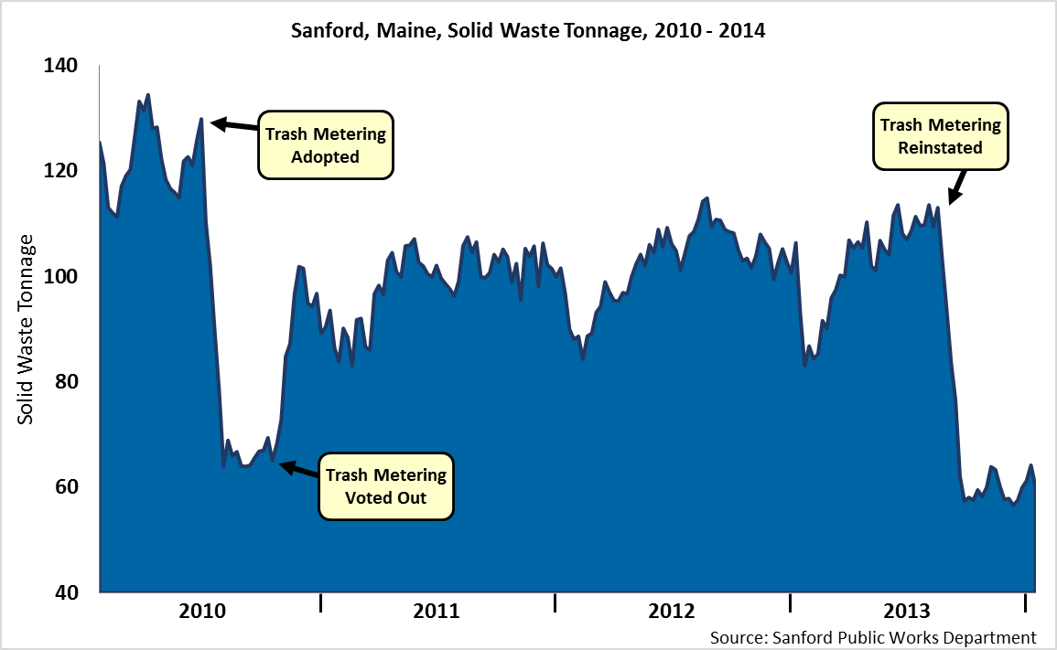
SMART Results
Results are highly consistent. The data spans decades across hundreds of municipalities with diverse demographics.
Waterville, Maine 54% Decline in MSW in 1 Year
Malden, Mass. 52% Decline in MSW Over 5 years
Dartmouth, Mass. 59% Decline in MSW
Sanford, Maine Powerful Message

Slide 11
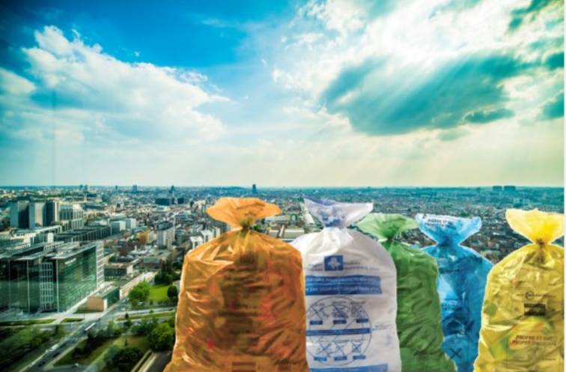
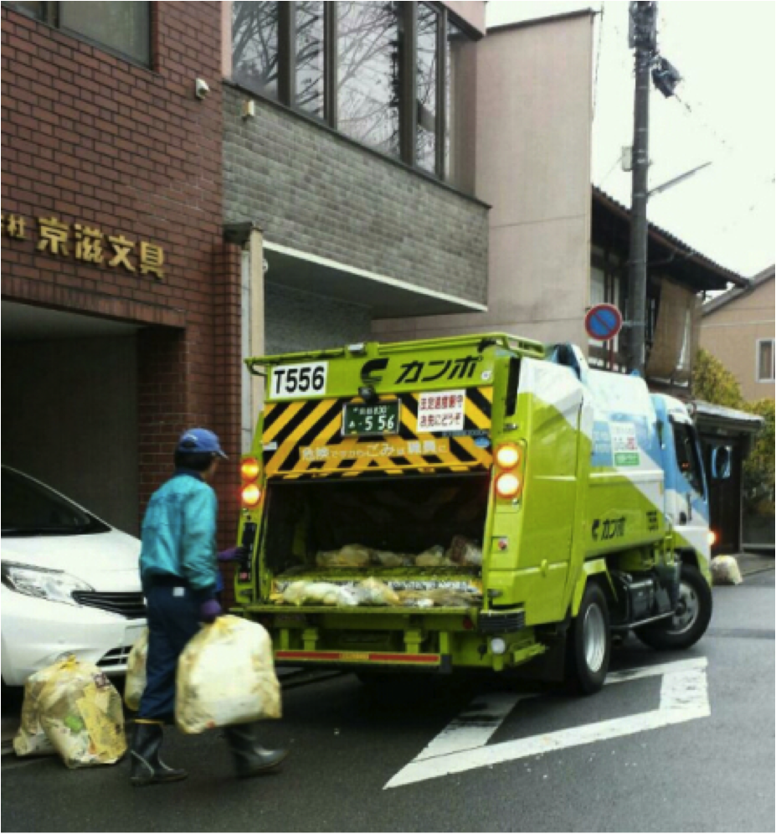
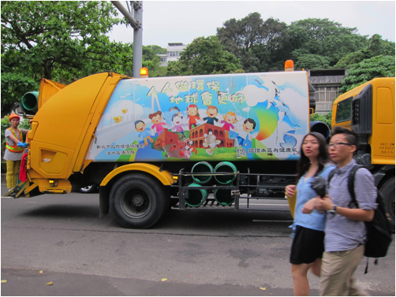
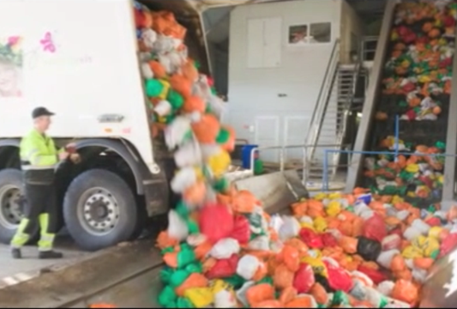
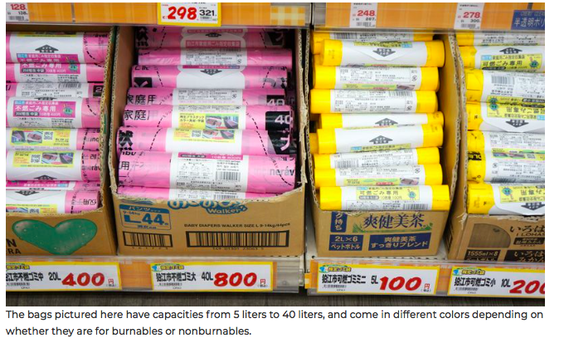
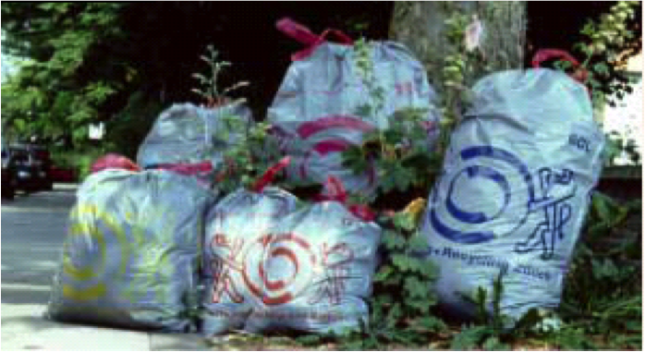
Global SMART Efforts (Selected Examples)
Europe
South Korea
Taiwan
ZeroWaste Europe’s 1st Category Municipalities must use SMART.
Low annual per capita disposal (300-500 lbs.) with SMART in:
Belgium
Austria
Switzerland
Estonia
France
Italy
Others
Seoul reduced waste 42%.
Taipei uses bag-based SMART.
Reduced waste by 33%
Recycling rate is >50%
Scandinavia
Japan
SMART – Zurich
Reduced Waste 41%
Kyoto reduced waste more than 40%.

Slide 12
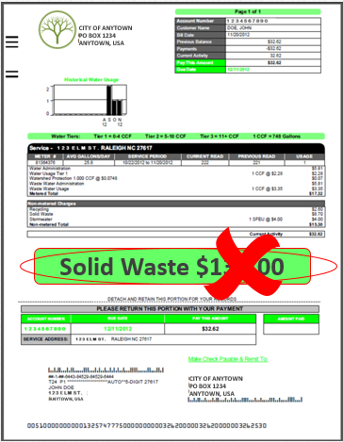
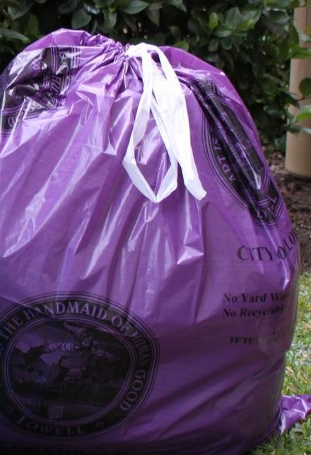
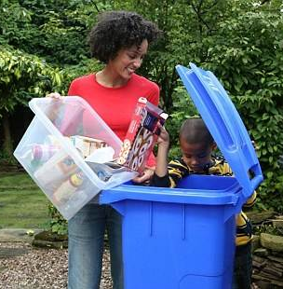
Bag-Based SMART
SMART treats trash like any other utility: Residents pay for the service based on how much of it they use. Bag-based SMART is the most effective available way to reduce residential trash, and it works with all collection methods.
1
Cut Fees
2
Pay per Bag for Trash
3
Residents Recycle More
Residents must use official municipal trash bags
Bags are sold at local grocery stores, etc.
Money goes to municipality to pay for trash collection and disposal
Residents have a financial incentive to reduce waste
Recycling and composting increases
Solid waste is reduced
Collection and disposal costs drop
Landfill life is extended
The environment is improved

Slide 13
Residential Trash Disposed per Capita (“DEEP Dive” Participants)
SMART communities dispose of less residential MSW per capita than most Connecticut cities and towns. For example, Portland, ME throws away 268 lbs. per capita.
CT Average
740
Mansfield
CT
498
Stonington
CT
364
Portland
ME
286
Note: Figures are calculated using MSW tonnage data provided by the municipalities themselves

Slide 14
Comparing Different Methods of SMART
Institute for Local Self Reliance (ILSR) 2017 Research
Avg. Annual Pounds Per Capita Residential Trash Disposal (PPC)
PAYT with Bags (Avg. 344 PPC)
PAYT with Variable Carts plus Curbside Food Collection (Avg. 510 PPC)
PAYT with Variable Carts no Curbside Food Collection (Avg. 560 PPC)
64 gallon Overflow Cart (Avg. 646 PPC)
CT average without SMART (~740 PPC)

Slide 15
Summary of Lessons Learned So Far
40 “DEEP Dives”; 10 additional analyses:
There was a positive response to the SMART concept from the majority of communities:
83% strong support from Department of Public Works (DPW) officials
79% strong support from the highest elected officials
75% strong interest from both DPW and the highest elected official (in the same municipality)
54% have taken steps (or plan to take steps) to move forward
Primary barriers:
Political fear
Hauler resistance (even in communities that have municipal collection)

Slide 16
Potential Pathways
CT DEEP has been exploring various pathways for making SMART the norm across the state. Currently, there are 4 potential pathways for doing this.
Traditional
Coalition-Led
Singular
State Approach
Legislative
Municipalities individually adopt SMART systems, with or without assistance from CT DEEP
Government coalitions like regional planning organizations or solid waste planning groups adopt SMART systems for their members
State oversees a SMART program
The State adopts a waste standard set low enough to require some form of SMART system
Today’s Discussion

Slide 17
Coalition-Led Pathway
Government coalitions adopt SMART systems for their members:
There are 9 Regional Planning Organizations (RPOs) and 8 Solid Waste Planning Groups (SWPGs) in CT.
RPOs or SWPGs could devise and adopt SMART systems and provide them for their members.
SMART participation would be mandatory for subscription and municipal haulers.
Revenues from the sale of SMART bags would flow to the coalition.
Revenues could be designed to cover recycling tip fees.
Each RPO/SWPG would use those funds to pay the tip (trash and recycling) fees.
Pros
Would provide an optimized, uniform solution for a coalition’s area of jurisdiction Would make SMART adoption easier for municipalities Would provide net (new) revenue for coalition to promote or assist with material management programs Would provide joint contracting ability
Cons
Would require close coordination with WTE facilities and municipalities regarding enforcement; Haulers that cross muni lines, would no longer be able to mix loads Would require unanimous consent from member municipalities

Slide 18
Today’s Presentation
1 | Why Should Connecticut Reduce its Waste?
2 | How Could Connecticut Reduce Waste?
3 | Baseline Data
4 | SMART Benefits Analysis
5 | Discussion and Next Steps

Slide 19
NECCOG Baseline Data
# of Municipalities in Analysis | 14
Est. # of Effective Households | 30,574
Est. Effective Population | 80,820
Estimated Average Tip Fee (Trash, per Ton)
Municipalities
Ashford
Brooklyn
Canterbury
Chaplin
Eastford
Killingly
Plainfield
Pomfret
Putnam
Scotland
Sterling
Thompson
Union
Woodstock
Current Est. Annual Material Generation | Tons | Lbs. per Capita
Residential Trash | 29,802 | 737
Residential Recycling | 8,964 | 222
Note: When actual data (trash tonnage, etc.) was available, it was used. When not available, it was estimated using CT state averages for towns with municipal curbside collection, subscription curbside collection, or drop-off as appropriate.

Slide 20
Today’s Presentation
1 | Why Should Connecticut Reduce its Waste?
2 | How Could Connecticut Reduce Waste?
3 | Baseline Data
4 | SMART Benefits Analysis
5 | Discussion and Next Steps

Slide 21
Impact on Annual Trash and Recycling Generation
Residential Tash
Residential Recycling
Trash reduction of 13,113 tons

Slide 22
Impact on Annual Waste Stream and Recycling Rate
Overall reduction of 7,868 tons of material
Recycling Rate:
23%
46%

Slide 23
Preliminary
Estimated Financial Impact on NECCOG
Implementing SMART would have the estimated impacts below, assuming a recycling tip fee of $50 per ton.
(Currently paid by municipalities)
(Would by paid by the COG; Municipalities would pay $0)
Annual Net Financial Impact :
Net Revenue from SMART Bags = | $2,122,000
Tip Cost = | $1,340,000
Recycling Tip Cost = | $710,000
Net Revenue = | $72,000
Revenue Assumptions:
Bag-based SMART
30 gal. bag, 60% of bag sales, $1.75retail price
15 gal. bag, 40% of bag sales, $0.90 retail price

Slide 24
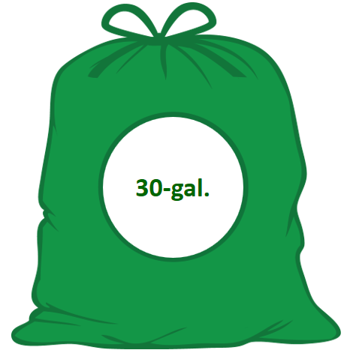
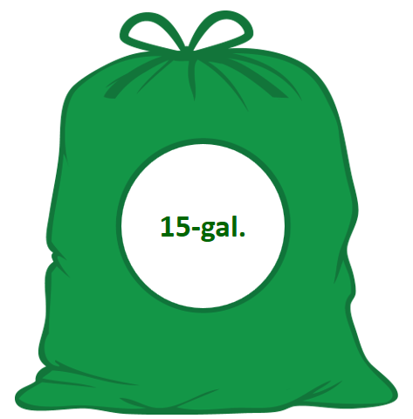
How SMART Bags Pay for Trash
33-gal.
15-gal
$1.75 per Bag
Bag & Bag Distribution | $0.31
Trash Incineration+ Recycling Cost + extra | $1.44
Total | $1.75
$0.90 per Bag
Bag & Bag Distribution | $0.21
Trash Incineration + Recycling Sots + extra | $.69
Total | $.90

Slide 25
Average HH Financial Impact
SMART shifts disposal costs to users and gives residents more personal control.
Per HH Spend, PAYT Bags | $85.85
Per Month | $7.15
Less Regular Trash Bags | $27.00
Net per HH Cost | $58.85
Per Month | $4.90
The average home will use…
…less than one bag per week

Slide 26
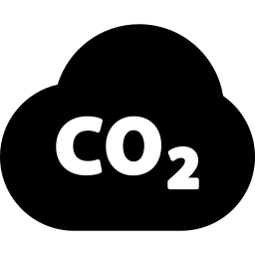
Statewide SMART Impact
SMART Impact Analyses – Trash Impact of SMART, Overall
The estimated trash reductions below assume full participation by all eligible municipalities for all WTEs.
Annual Waste Stream Impact
Annual Capacity without Mid-CT (MIRA) WTE: 1,492,850 tons
Annual Enviro. Impact Residential SMART Only Res. + Commercial SMART
 | Tons of Trash Reduced | Metric Tons of CO2 Reduction | Cars Removed from Roads | Gallons of Gas Saved | Homes Powered | Solar Panels Installed
 | 455,400 | 859,000 | 168,000 | 96,267,000 | 64,000 | 887,000
 | 834,900 | 1,574,000 | 309,000 | 176,490,000 | 117,000 | 1,625,000

Slide 27
Annual Environmental Impact
Reducing annual trash by 13,113 tons would have a very positive environmental impact, per the US EPA’s WARM (Waste Reduction Model).
Each year, equivalent to:
 | Eliminating 25,000 metric tons of greenhouse gases (MTCO₂e)
 | Removing 4,800 cars from the roads
 | Saving 2,772,000 gallons of gas
 | Saving enough energy to power 1,800 homes

Slide 28
Today’s Presentation
1 | Why Should Connecticut Reduce its Waste?
2 | How Could Connecticut Reduce Waste?
3 | Baseline Data
4 | SMART Benefits Analysis
5 | Discussion and Next Steps

Slide 29
Discussion and Next Steps
Questions?
Comments or Input?
Discussion Regarding Next Steps

