Slide 1

Tackling Connecticut’s Rising Waste Costs
Kevin Budris
Staff Attorney, Zero Waste Project
P: 401-228-1910
E: kbudris@clf.org

Slide 2
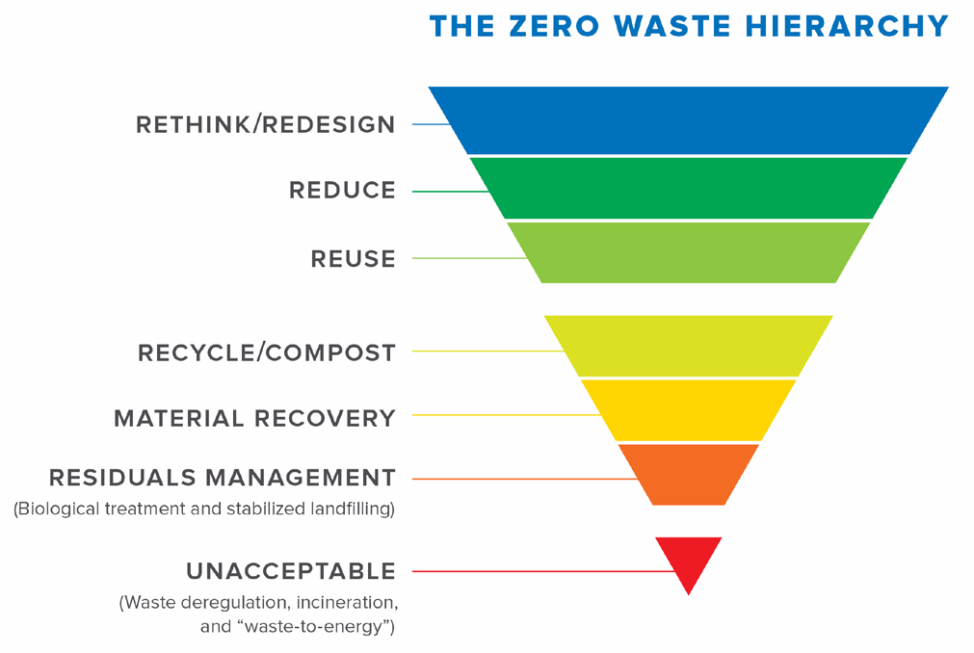

Conservation Law Foundation
Protecting New England’s environment for all people

Slide 3
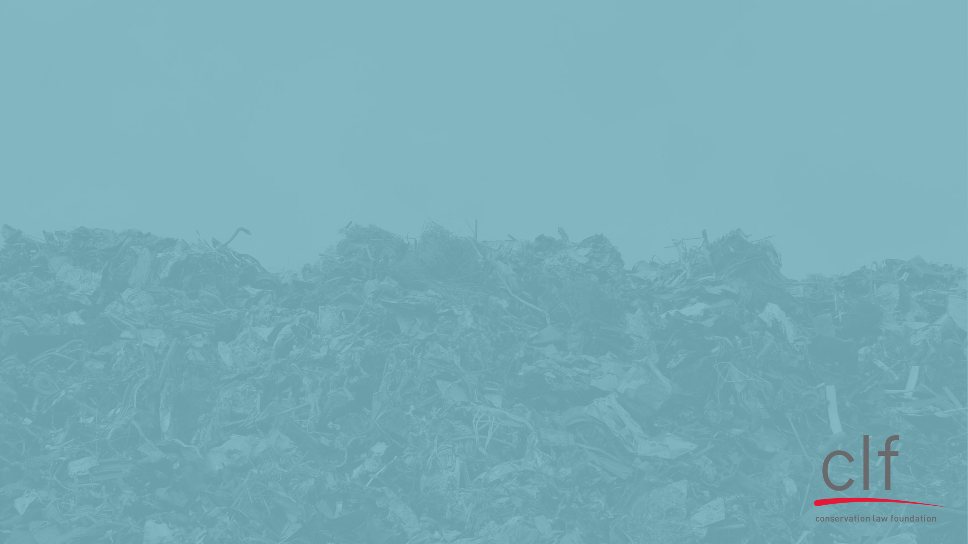
2.8 MILLION TONS PER YEAR
Waste and residential recycling overview
Benefits of an upgraded and expanded bottle bill
Moving beyond single-use plastics

Slide 4
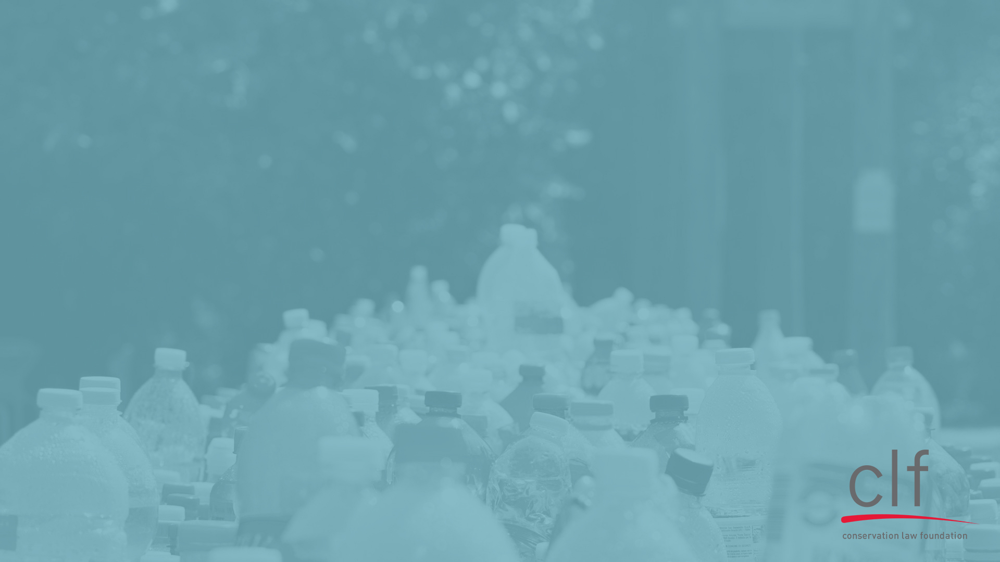
Connecticut Waste and Recycling

Slide 5
Municipal Solid Waste
Up to 8.7% (200,000 tons) single-use plastic
1.1% (>26,000 tons) PET plastic containers
1.6% (~37,000 tons) glass containers
Statewide:
2.3 Million Tons Per Year¹
¹Source: 2015 CT Statewide Waste Characterization Study

Slide 6
Residential Recycling
3.4% PET plastic containers
17.5% glass containers and broken glass
Statewide: Approximately
500,000 Tons Per Year²
²Source: 2016-2017 CT DEEP Solid Waste Data; 2015 CT Statewide Waste Characterization Study

Slide 7

Towns and Cities
are Footing the Bill
Tipping Fees for MSW are $60-$90+ per ton
Curbside single-stream recycling now costs $20-$70+ per ton

Slide 8
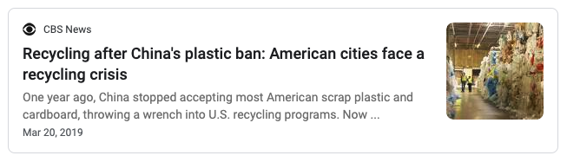
Our Recycling Crisis
Bridgeport: +$129,512/year → -$394,380/year
Milford: +$85,000/year → -$250,000/year
Hamden: $0 → -$190,000/year
North Haven: +$0/ton → -$70/ton³
³Source: Connecticut Conference of Municipalities

Slide 9
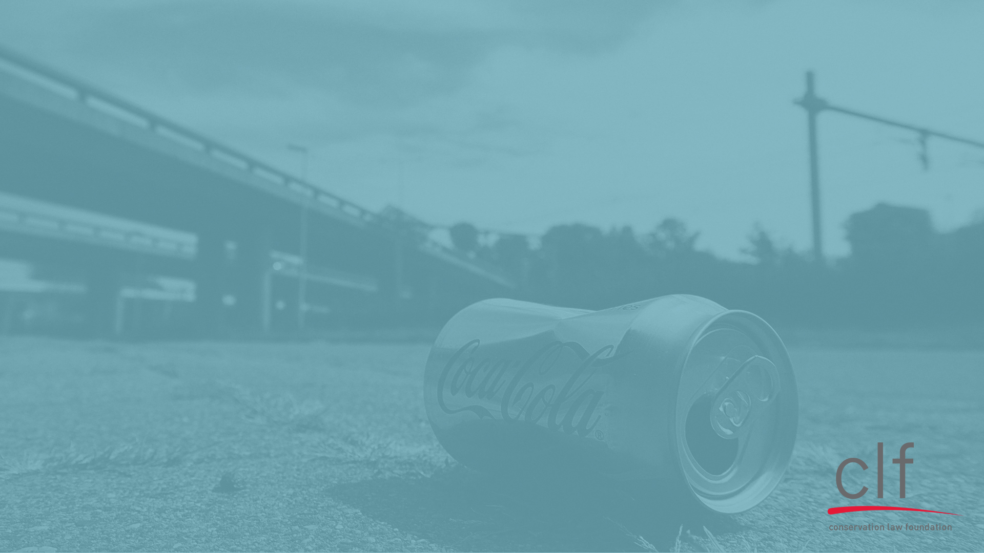
Upgrading and Expanding
the Bottle Bill
The problems: plastic and glass
A solution: divert material to the system that works
Savings for cities and towns
Other benefits of an upgraded, expanded bottle bill

Slide 10
Problems with Plastics

Slide 11
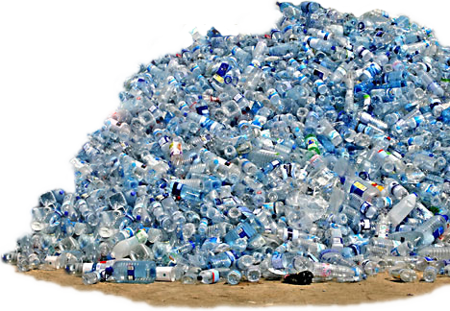
Plastic Recycling is Limited
5.6%
166,500 tons into new bottles⁴
537,500 tons turned into flake
2,956,500 tons PET bottles in US in 2017
⁴2017 NAPCOR Report on Postconsumer PET Container Recycling Activity

Slide 12
Plastic Recycling Rates: A PET Study
Non-Redeemed PET
 | MSW | Recycling Facilities
2009 tonnage | 26,391 tons⁵ | 7,671.64 tons⁶
Percentage | 77.5% | 22.5%
Turned into flake | 0% | 68%⁷
At most, 15.3% of non-redeemed PET is made into flake
⁵Source: 2010 CT Statewide Waste Characterization Study
⁶Source: CT DEEP FY2009 Destinations and Amounts of Material Reported Sent out for Recycling from Connecticut Permitted Solid Waste Facilities
⁷Source: 2017 NAPCOR Report on Postconsumer PET Container Recycling Activity

Slide 13
Plastic Recycling Rates: A PET Study
By contrast, 88% of the PET that is returned to a redemption center is made into flake⁸
≤15.3% vs. 88%
⁸Source: NAPCOR Report on Postconsumer PET Container Recycling Activity in 2017

Slide 14
Plastic Containers in Connecticut
PET plastic containers comprise 3.4% of single-stream recycling and 1.1% of MSW in Connecticut⁹
This amounts to more than 43,000 tons of recycling and waste
⁹Source: 2015 CT Statewide Waste Characterization Study

Slide 15
Problems with Glass

Slide 16
Glass Recycling Rates
On average, 40% of glass from single-stream collection is recycled into containers and fiberglass
By contrast, 98% of glass from deposit-return systems is recycled into containers and fiberglass¹⁰
40% vs. 98%
¹⁰Source: CRI, Understanding economic and environmental impacts of single-stream collection systems

Slide 17
Glass Containers in Connecticut
Glass containers and broken glass comprise 17.5% of single-stream recycling and 1.6% of MSW in Connecticut¹¹
Mixed glass has an average value of -$20/ton in recycling markets¹²
¹¹Source: 2015 CT Statewide Waste Characterization Study
¹²Source: The Aluminum Association, Key Sustainability Performance Indicators September 2019

Slide 18
Glass in Single-Stream
Broken glass in single-stream recycling contaminates paper and cardboard, decreasing their value
CT single-stream recycling is 61.1% carboard and paper
305,000+ tons statewide

Slide 19
Diverting Material to the System that Works

Slide 20



Increase the Deposit to 10¢
Connecticut
5¢ deposit → 48.5% return rate
Michigan
10¢ deposit → 92% return rate
  Oregon
  5¢ deposit in 2016 → 65% return rate
  10¢ deposit in 2018 → 90% return rate

Slide 21


Expand the Scope: Glass
Include all glass containers in the bottle bill – especially wine and liquor bottles
Vermont
15¢ deposit on liquor bottles
→ 84% return rate in 2017
Maine
15¢ deposit on wine/liquor bottles above 50 mL
→ 87.2% return rate in 2016

Slide 22
Expand the Scope: Plastic
Include all #1 plastic containers in the deposit-return system
More than 3.4% of residential recycling
43,000 tons of recycling and waste¹³
¹³Source: 2015 CT Statewide Waste Characterization Study

Slide 23
Savings for Cities and Towns

Slide 24
Reducing MSW Tipping Fees
Connecticut tipping fees average $60-$90+ per ton
Municipal Solid Waste
1.1% #1 plastic containers
1.6% glass containers
.2% aluminum beverage containers
= 3.0% or 69,000+ tons¹⁴
¹⁴Source: 2015 CT Statewide Waste Characterization Study

Slide 25
Reducing Recycling Costs
Residential recycling costs $20-$70+ per ton
Single-Stream
3.4% PET plastic containers
17.5% glass containers or broken glass
.6% aluminum beverage containers
= 23.4% or 107,000+ tons¹⁵
¹⁵Source: 2015 CT Statewide Waste Characterization Study

Slide 26
Glass in Single-Stream
Even ignoring processing and collection costs, on average, MRFs must pay $20/ton to dispose of glass¹⁶
Glass containers and broken glass comprise 17.5% of single-stream recycling and 1.5% of MSW in Connecticut¹⁷
Glass contaminates carboard and paper, decreasing the value of those materials
¹⁶The Aluminum Association, Key Sustainability Performance Indicators September 2019
¹⁷2015 CT Statewide Waste Characterization Study

Slide 27
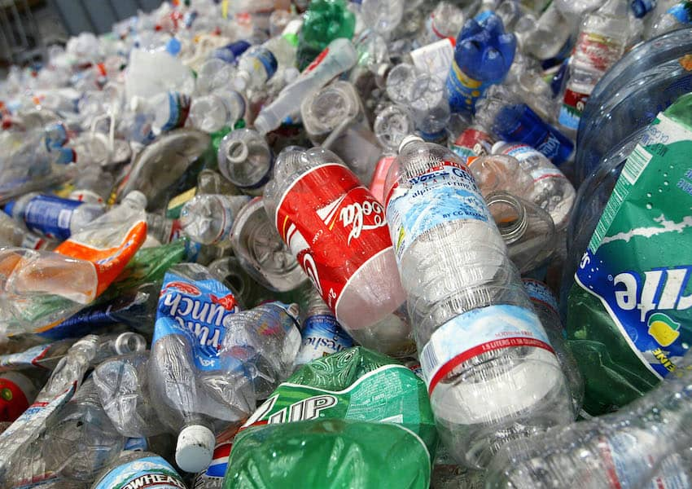
Bottle Bill Impact Studies
Since 2009, studies by DSM Environmental Services in Massachusetts, Rhode Island, Washington, and Minnesota have confirmed that deposit-return systems can save cities and towns $500-$1,200 per 1,000 persons per year¹⁸
¹⁸Source: Reloop, Deposit Return System: Studies confirm big savings to municipal budgets

Slide 28
Other Benefits of the Bottle Bill

Slide 29
Benefits of the Bottle Bill
Jobs: deposit-return systems provide 11 to 38 times more jobs than curbside recycling systems¹⁹
Litter reduction: across the U.S., deposit systems have resulted in 70-84% reductions in beverage container litter and total litter reductions of 34-47%²⁰
Energy savings and reduced emissions: a nationwide deposit system could save the equivalent of 2.9 million households’ annual energy use and avoid greenhouse emissions equivalent to 2.9 million cars²¹
¹⁹Resource Recycling, Returning to Work
²⁰CRI, Litter studies in bottle bill states
²¹CRI, Bottled Up: Beverage Recycling Stagnates (2000-2010)

Slide 30

Transition to Refillables
The deposit-return system can be used for refillable containers
The more we support and expand collection systems, the more prepared the network will be for refillables
Quebec and Oregon have refillable systems supported by their existing deposit-return infrastructure

Slide 31
Bottle Bill Wrap-Up:
An updated and expanded bottle bill will divert more material to a recycling system that works
Towns, cities, and individuals will save money
An expanded bottle bill will increase the value of materials that remain in residential recycling
The deposit return system provides jobs, reduces litter, and saves energy

Slide 32
Moving Beyond Single-Use Plastics

Slide 33

Plastic Recycling is Limited
CT incinerated approximately 275,000 tons of plastic in 2014²²
CT recycling facilities marketed approximately 15,000 tons of plastic in 2014²³
²²2015 CT Statewide Waste Characterization Study
²³Estimates of Connecticut MSW Generated, Disposed, and Recycled FY2014

Slide 34
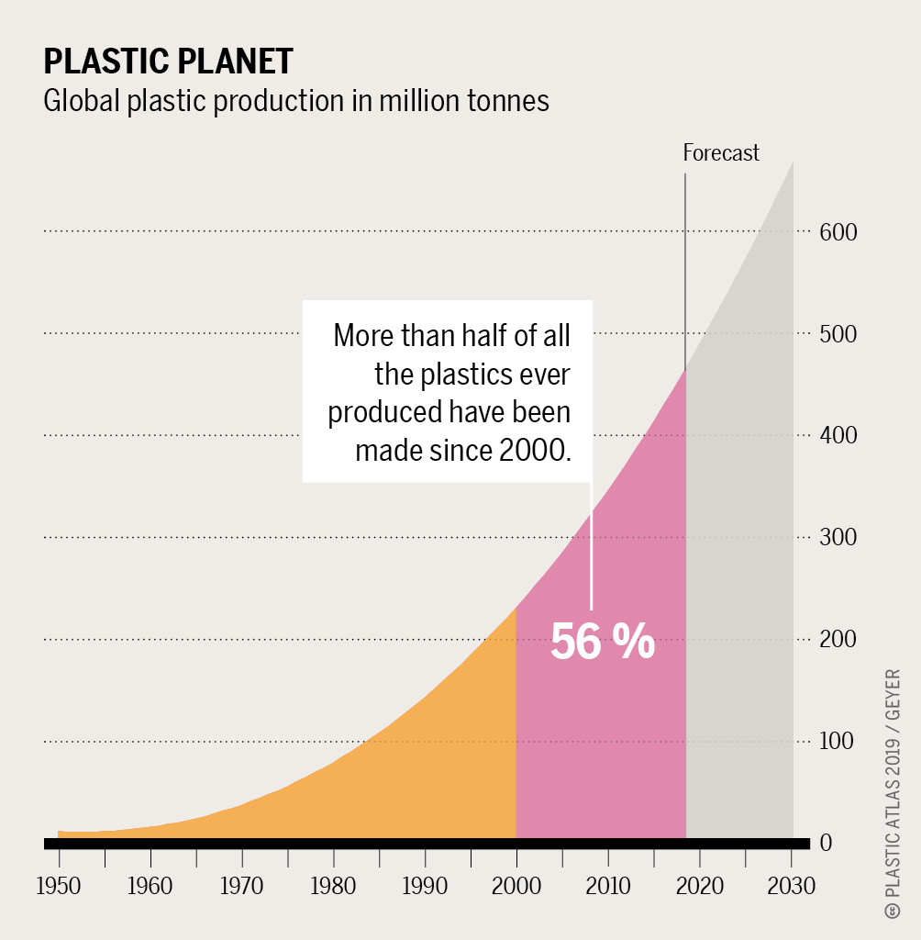
Plastics Production is Growing
Global Plastics Production:
1950 = 2,000,000 metric tons
2015 = 380,000,000 metric tons
2050 = 1,800,000,000 metric tons²⁴
²⁴Source: Azouly, Plastic & Health: The Hidden Costs of a Plastic Planet

Slide 35
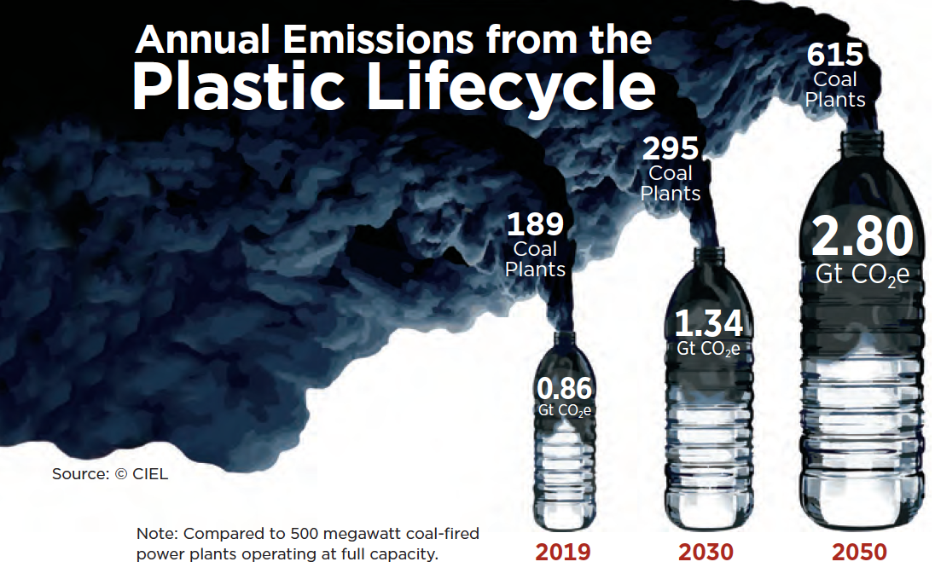
Plastics and Climate
If these trends continue, emissions from plastics production and incineration will consume 10-13% of the planet’s remaining carbon budget²⁵
²⁵Source: Hamilton, Plastic & Climate: The Hidden Costs of a Plastic Planet

Slide 36
Plastics Pollute at Every Stage
Fossil fuel extraction → releases more than 170 chemicals known to cause cancer and liver, kidney, reproductive, and/or development toxicity
Refinement → releases carbon monoxide, nitrogen oxides, benzene, and toluene
Incineration → releases dioxins, PCBs, VOCs, etc.
Plastic litter → breaks down into microplastics in our water, air, and food²⁶
²⁶Azouly, Plastic & Health: The Hidden Costs of a Plastic Planet

Slide 37
Moving Beyond Plastics
We cannot recycle our way out of the plastics problem
The only way to solve the myriad problems caused by single-use plastics is to stop the manufacture and distribution of single-use plastics
Plastics comprise more than 10% of the MSW and recycling that your communities and residents are paying for²⁷
²⁷2015 CT Statewide Waste Characterization Study

Slide 38
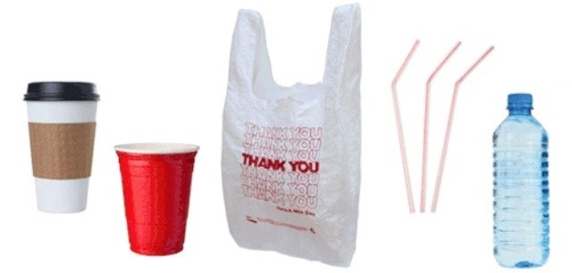
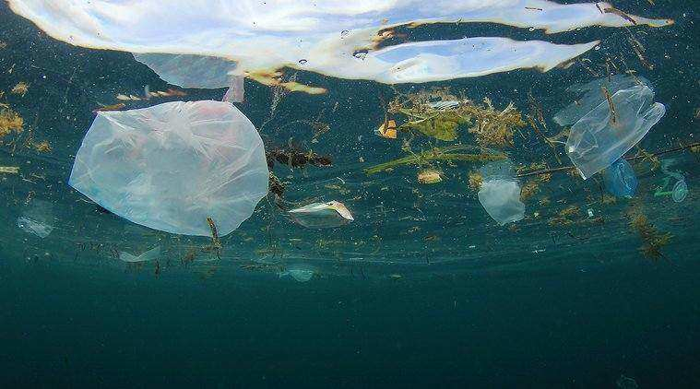
Single-Use Plastics Bans
Up to 200,000 tons of the plastics incinerated each year in Connecticut are single-use plastics
16,900 tons plastic bags
14,500+ tons polystyrene
Single-use plastics bans stop plastics pollution at its source

Slide 39
EPR for Packaging
Producers Design Packaging
Towns Handle Packaging Waste
Instead → producers manage collection and disposal of packaging waste or pay for the cost of recycling
COSTS
Towns
Producers
Goals → lift burdens off towns and incentivize reusable or easy to recycle packaging

Slide 40
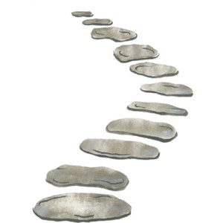
The Path Ahead
An upgraded bottle bill, single-use plastics bans, and EPR for packaging are all steps on a path that lead us away from wasteful, toxic plastics and toward refillable, reusable solutions

Slide 41
Next Steps
Work with your legislators to support the bottle bill
Help fight single-use plastics at the local level:
  Pass single-use plastics bans
  Support EPR for packaging
Reach out with any questions:
  401-228-1910
  kbudris@clf.org

Slide 42
Thank You!

