Slide 1

Environmental Depot
Maureen Nicholson, First Selectman,
Town of Pomfret

Slide 2




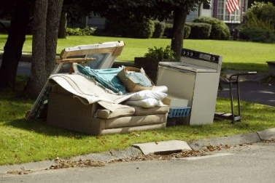
What Happens to Our trash now?
Recycling and Waste Incineration
So much Waste. So many challenges.

Slide 3
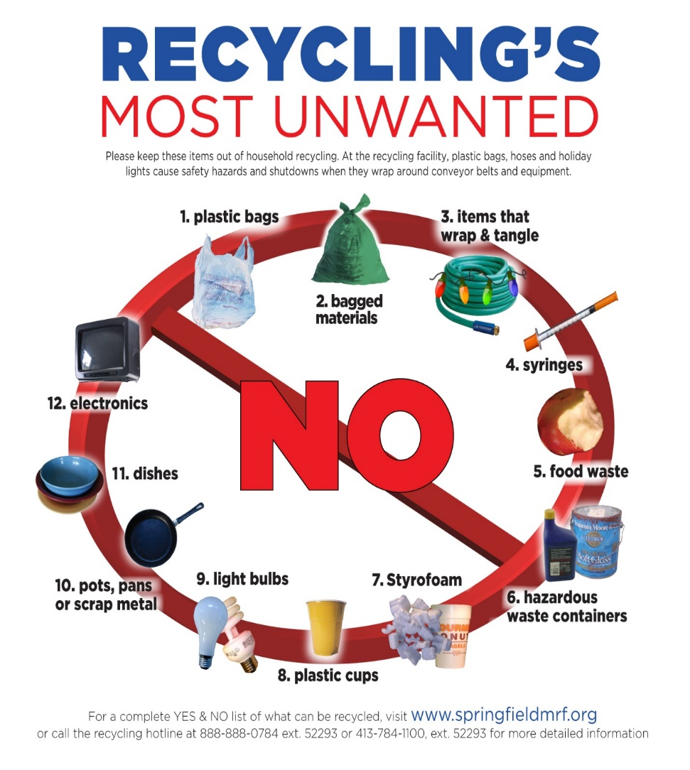
What are the challenges?
some of the
Single Stream Recycling
It seems so easy…
…but in reality, dirty containers contaminate clean containers and paper/paperboards, reducing value;
Conflicting info on what to do with certain items (batteries, etc.);
Wishful thinking leads to inclusion of non-recyclable items that clog up machinery.

Slide 4
New
Rules for
Recycling

Slide 5
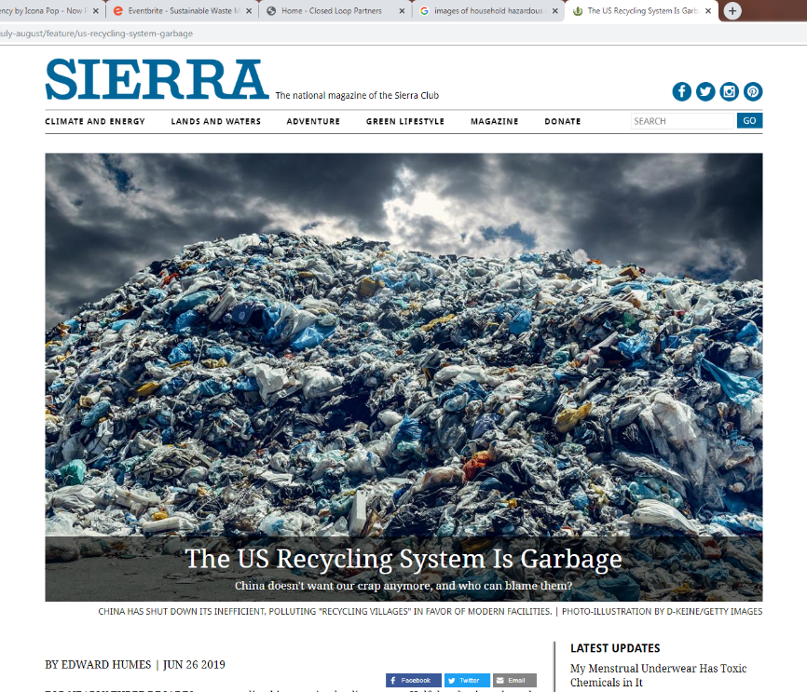
Waste Disposal is a Hot Topic these days!
A very complex issue that we all share responsibility for.

Slide 6
What are the challenges?
some of the
Waste-to-Energy Plants, i.e.: incineration
Cons
  Updating Regulations = changing standards, difficult to modernize existing sites
  Public opposition
  Air & water quality concerns
  Requires permanent landfilling
  (creates a brownfield)
  Long-term monitoring / liability
Pros
  Creates electricity from our waste.
  Reduces volume of trash.
  Some filter out metals for recycling thus further reducing volume of ash needing to be landfilled.

Slide 7
NE CT towns have intermittent Household Hazardous Waste Collection Days
Expensive
Limited to HHW
Low Participation
Inconvenient
Encourages improper disposal

Slide 8
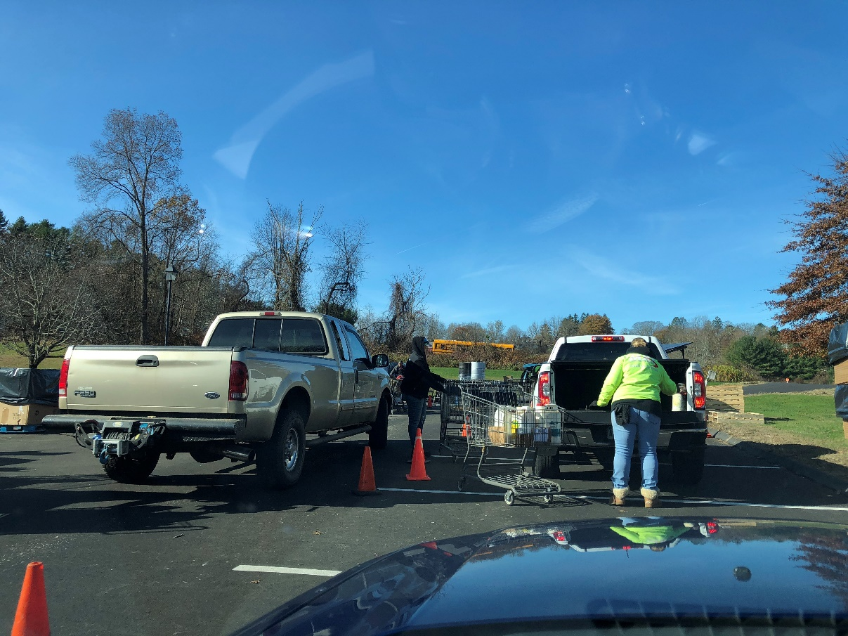
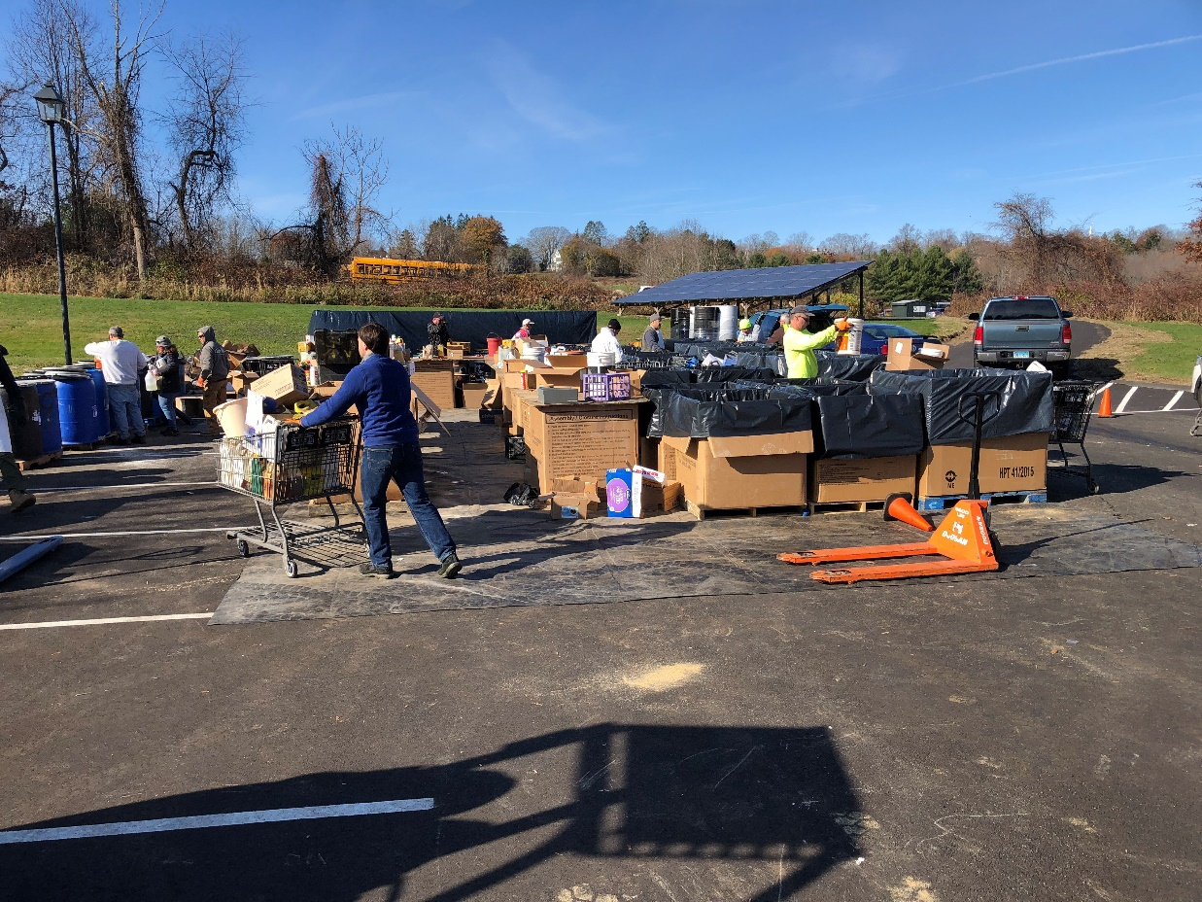
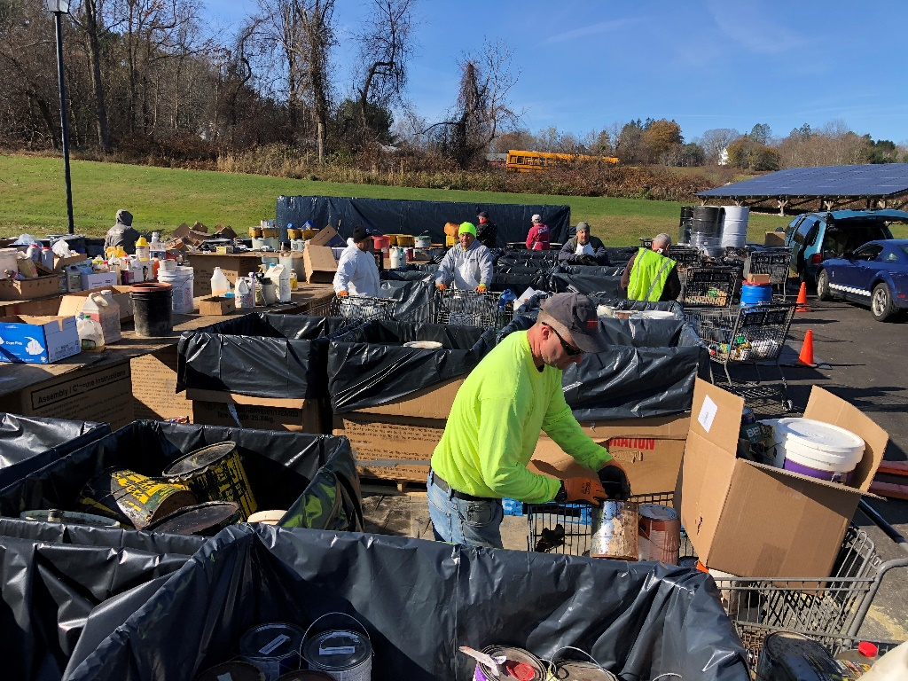
HHW Collection 11/9/19

Slide 9
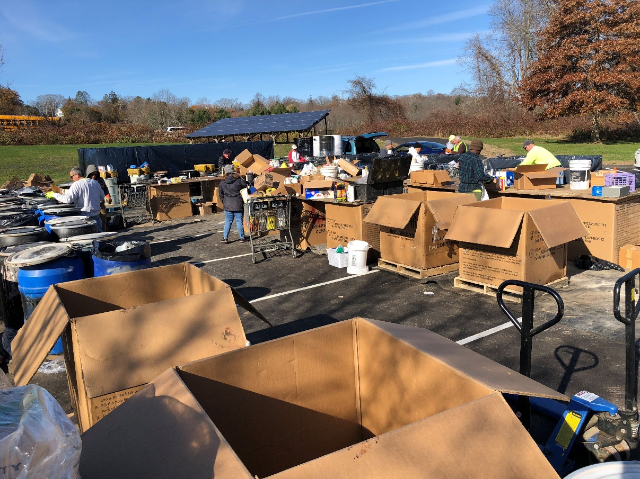
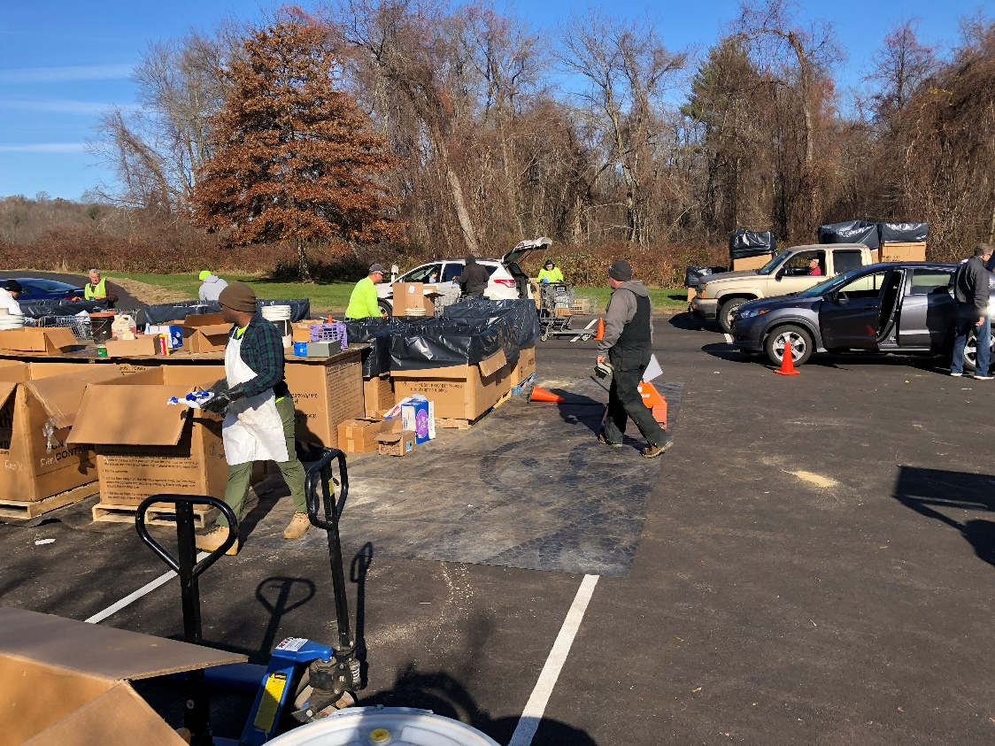

Slide 10
Cost Breakdown for 4 hours every 2 years for 410+/- households.
Total Cost of Disposal_________________
Recycling $1,860
Fuels Blend $5,660
Treatment $5,480
Incineration $6,380
Set Up Fee $1,000
Total $20,380
What happens to the rest of the HHW from all the other households?

Slide 12
What if we did things differently?

Slide 13
What if we look at our waste as a resource and not simply as a disposal problem & a liability?

Slide 14
What’s Still in Our Trash?
CT DEEP. 2015 Statewide Waste Characterization Study. March 15, 2016. p. 11

Slide 15





What Could Happen Then?
Remove difficult-to-dispose-of items from general waste stream to facilitate recycling.
Reduce the Waste. Tackle the challenges.

Slide 16
A new approach: The Environmental Depot
Bulky Waste
Pervious parking
Rain Gardens
Purposes:
Provide a regional solution –
a convenient & environmentally friendly waste disposal option
saving towns $$.
Assists CT in achieving goal: 60% diversion of materials from disposal by 2024.
DEPOT
Solar
Compost

Slide 17
Environmental Depot proposed for southeastern Pomfret, CT, i.e.: central to the NECCOG Region.
NECCOG region

Slide 18
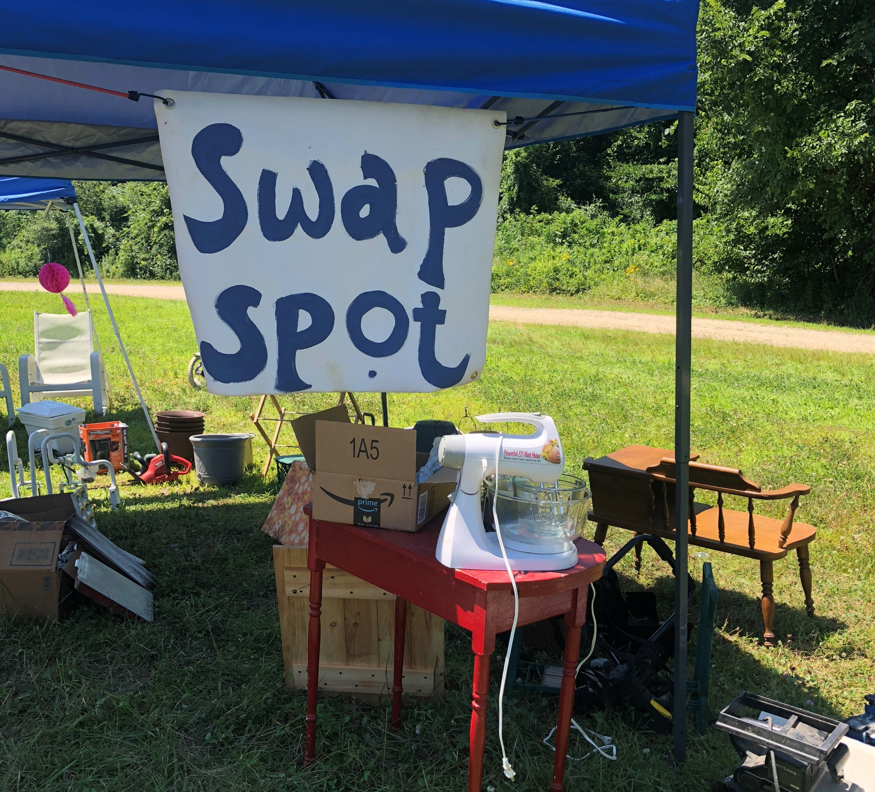
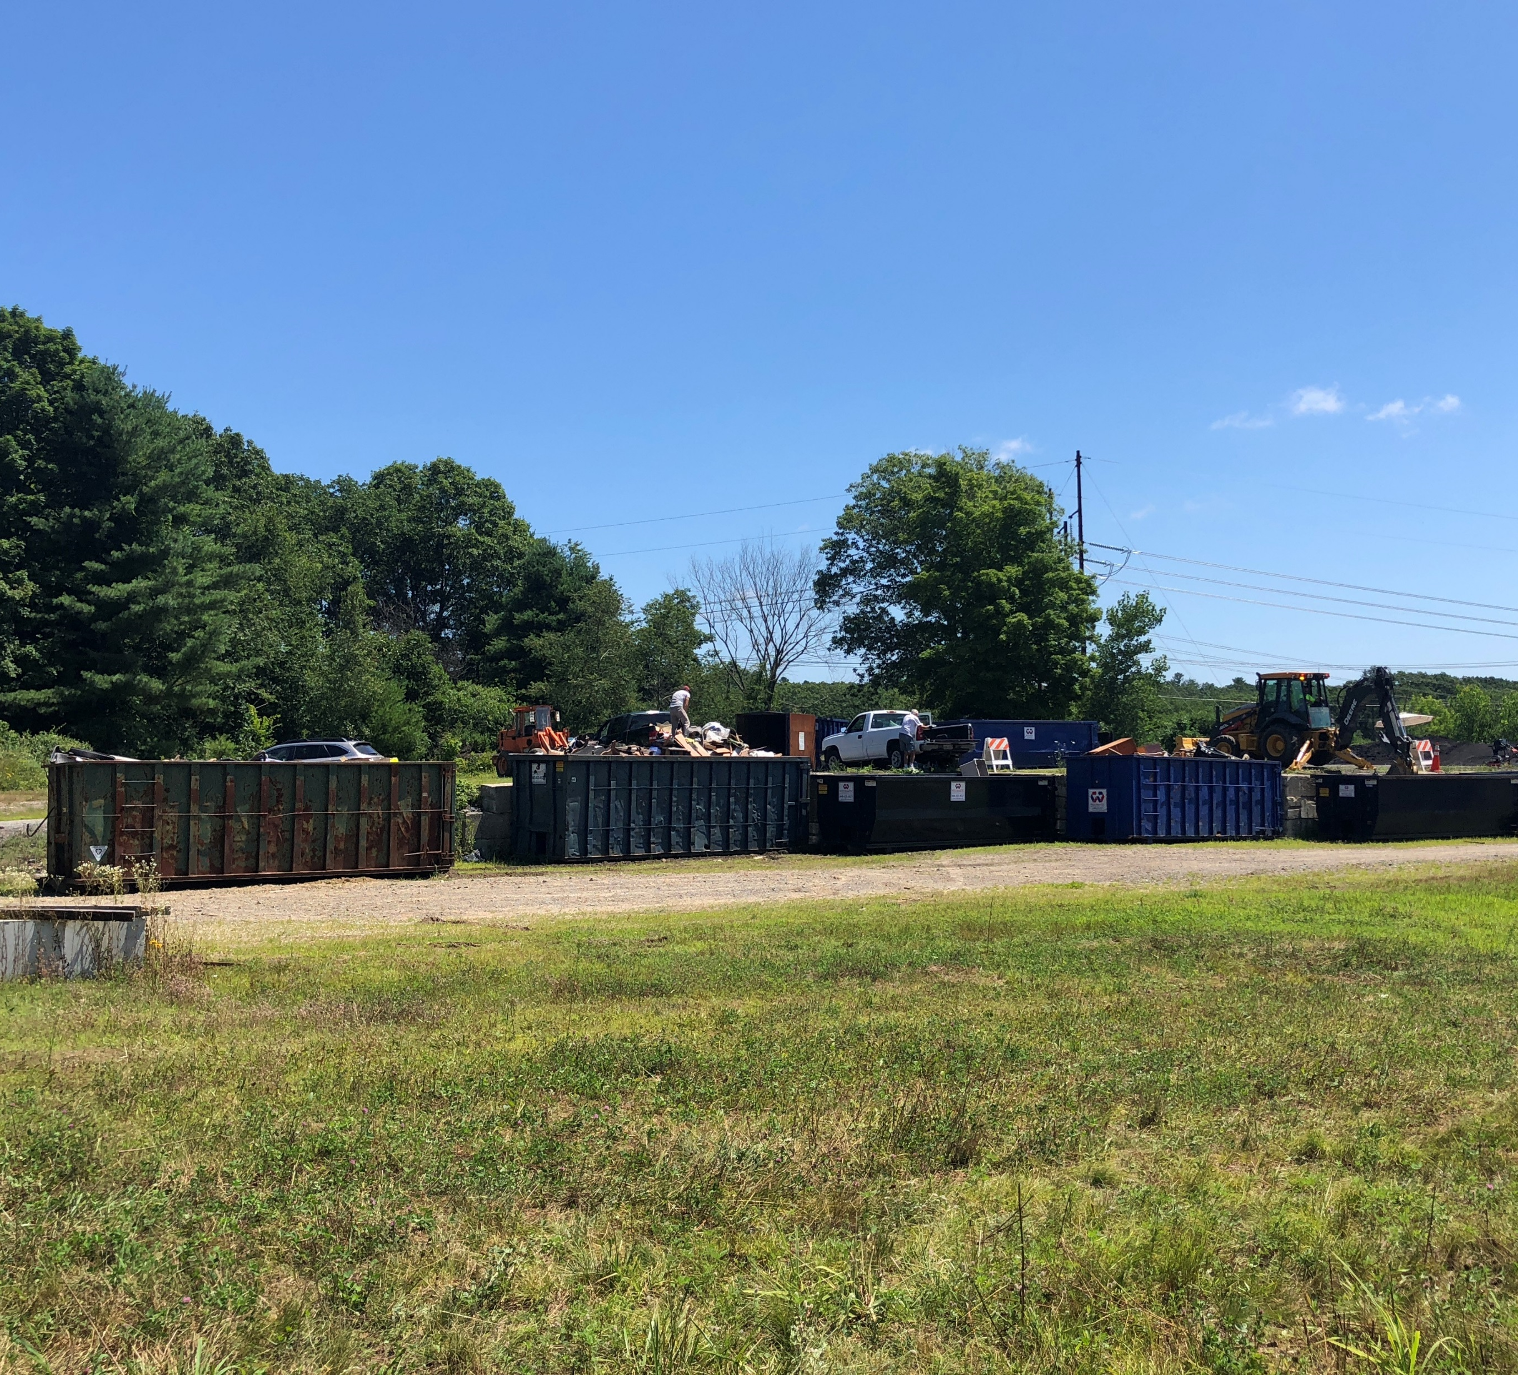
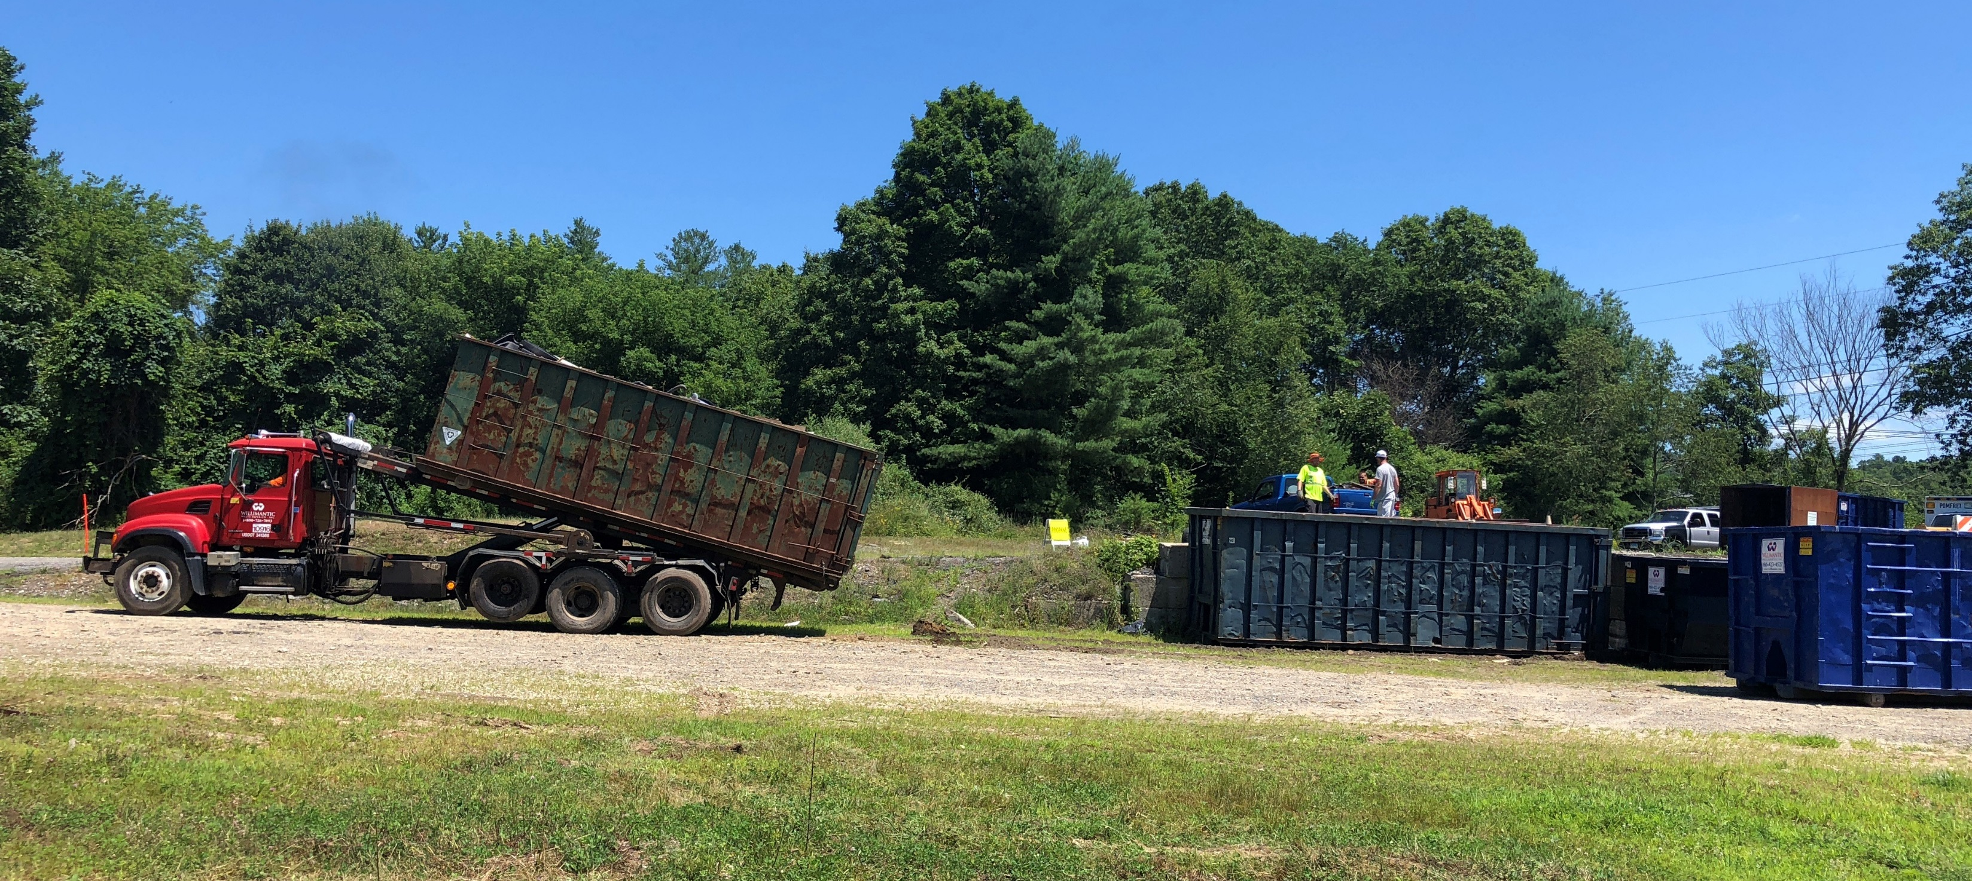
Pomfret is rethinking bulky waste collection

Slide 19
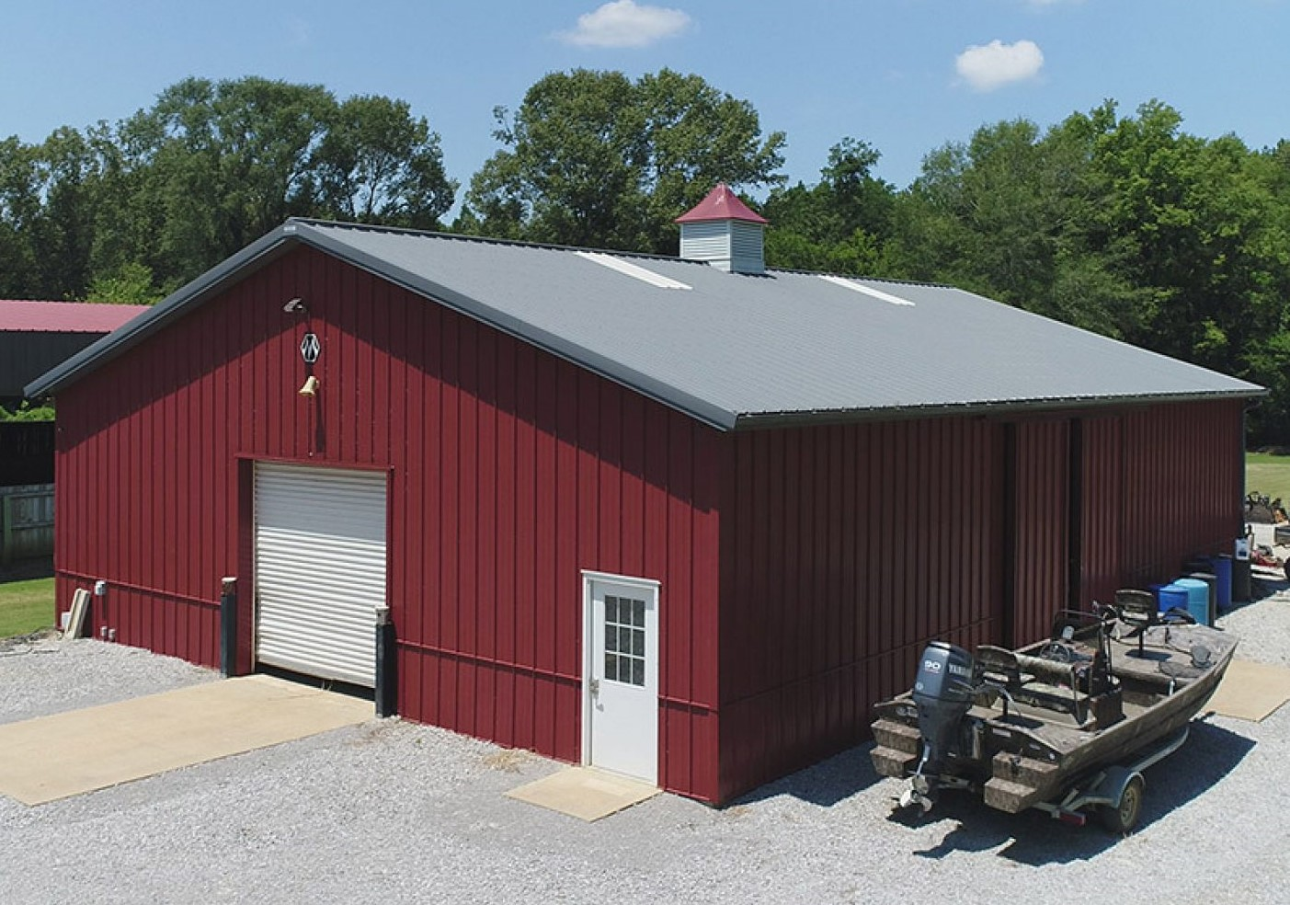
Proposed Indoor Regional Facility
1st enclosed HHW facility in the state
Open Year-round
State of the Art Design
  Safe Containment
1st Sustainable Demonstration Site in the State
Proposed type of structure for the
Environmental
Depot

Slide 20

The Environmental Depot will:
Collect: Household Hazardous Waste, i.e.: toxic, flammable, reactive or corrosive items

Slide 21
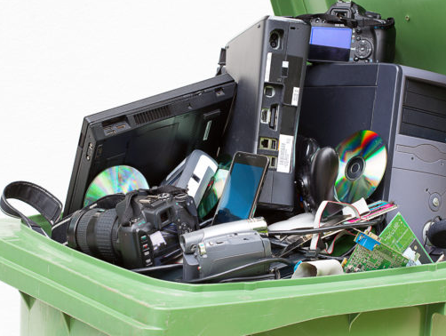


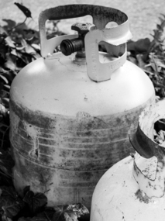




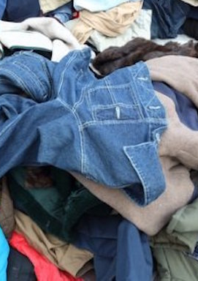

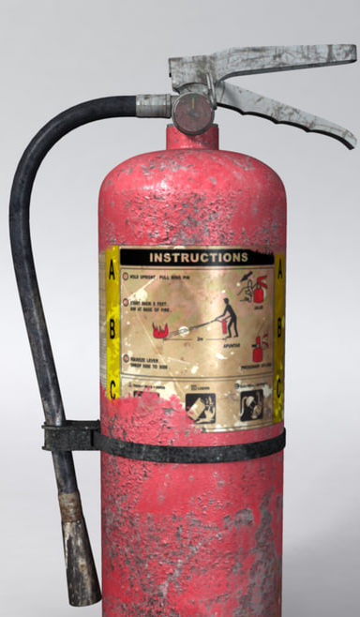
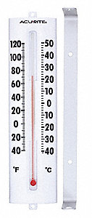

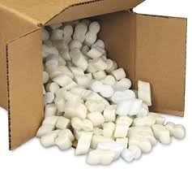
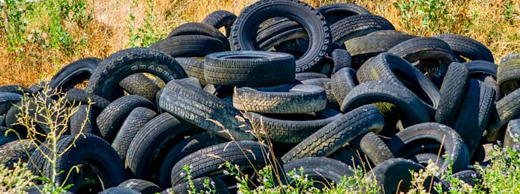
The Environmental Depot may also collect other items

Slide 22
The Environmental Depot may:
Demonstrate new approaches for site design, land uses, etc.
  Sustainable & Low Impact Development Methods:
  Rain Gardens, Lawn Alternatives, Bioretention Areas, Riparian Buffers, Rainwater collection, Pervious Parking, Ground Mounted Solar Panels, Composting, Alternative Septic / Greywater Systems
Possible Alternative Reuse Options for:
Concrete from Crumbling Foundations
&
Ash from Waste-to-Energy Plants….
and more we have yet to identify!

Slide 23
The Environmental Depot may:
Provide “How to” Workshops, Classes & more
Build a Rain Garden/ Pollinator Garden
Create an Edible Landscape
Composting
Identify & Remove Invasive Plants
Do Companion Planting to Reduce Nuisance Weeds & Pests
Kids Workshop: Plant a Veg & Take It Home
Solar Panels: Rooftop vs. Ground Mounted
Green Home Makeover
Sustainable Home Design
Tiny Homes
Green Home or Energy Audits
Earth Day Arts & Crafts Show
Upcycle or Reduce-Reuse-Recycle Science Fair

Slide 24
For More Information:
Maureen Nicholson, First Selectman, Town of Pomfret
860-974-0191
maureen.nicholson@pomfretct.gov
John Filchak, Executive Director, NECCOG
860-774-1253
john.filchak@neccog.org
Delia Fey, AICP, Senior Regional Planner, NECCOG
860-774-1253 x20
delia.fey@neccog.org

