Slide 1
Eastern Connecticut Land Bank, Inc. A CT-Certified Brownfield Land Bank

Slide 2
Our Presentation to NECCOG
Introduction to Brownfield Land Banks and ECLB
Our Mission and Vision: How ECLB Will Help the Towns of Eastern Connecticut?
Our Challenges: How Can the Towns of Eastern CT Help ECLB?

Slide 3
What is a Brownfield Land Bank?
Dedicated to helping communities deal with their most troublesome brownfield properties
CT Public Act 17-214 authorized CT DECD to certify “Connecticut Brownfield Land Banks”
A non-stock, non-profit, community-based corporation

Slide 4
ECLB’s Mission:
To partner with municipalities in Eastern Connecticut to support the return of distressed, underutilized, blighted, brownfield and historic properties to productive uses consistent with local Plans of Conservation and Development.

Slide 5
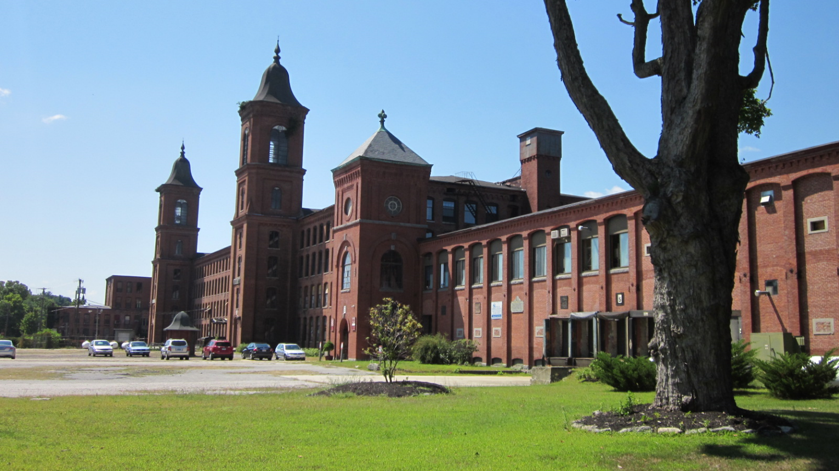
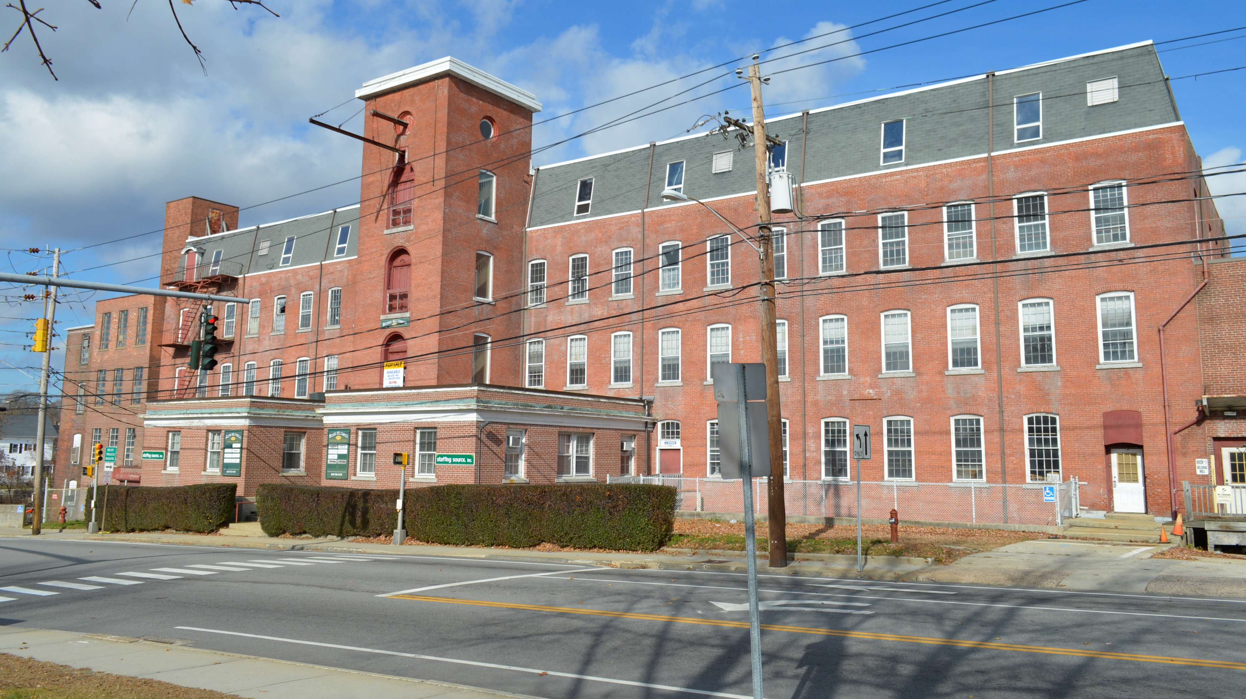
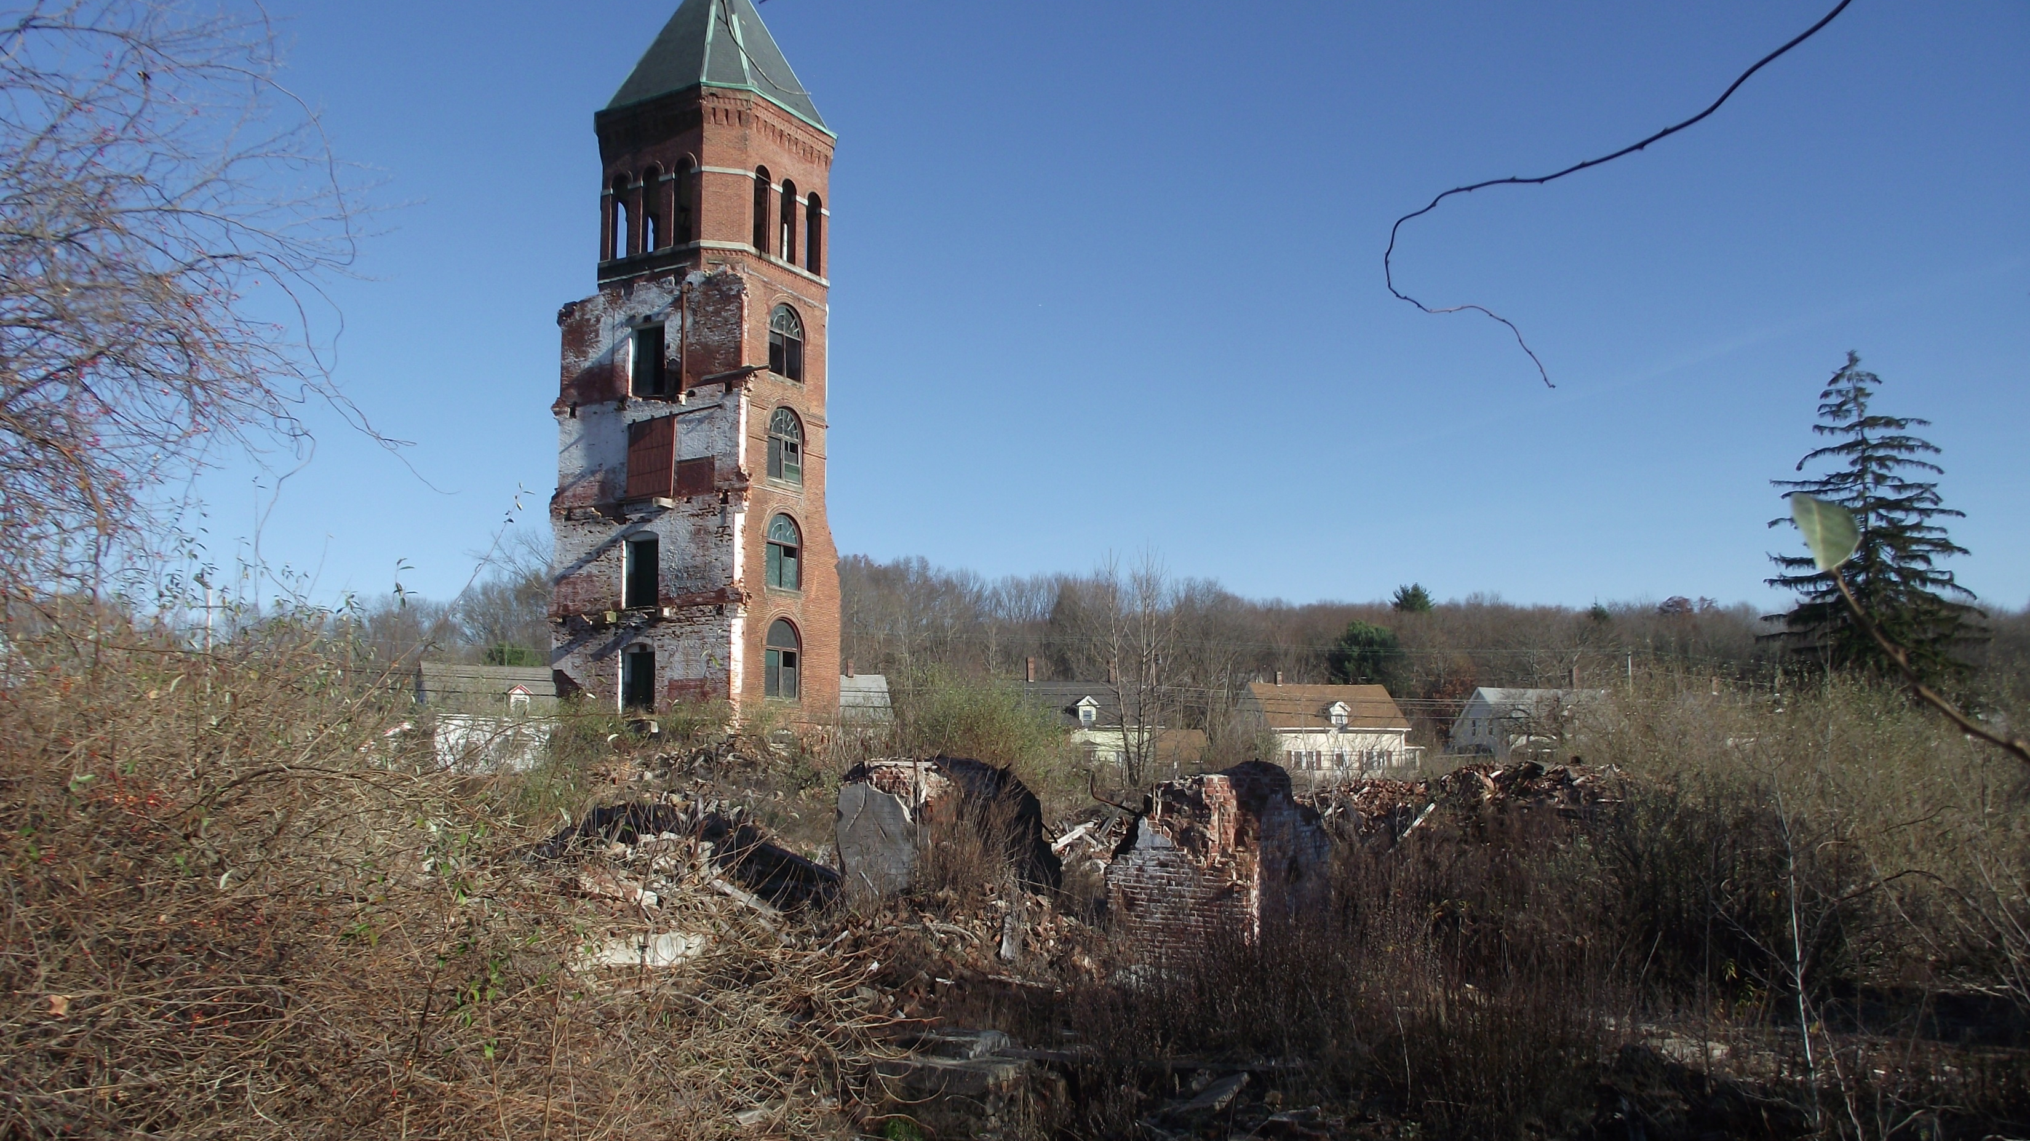
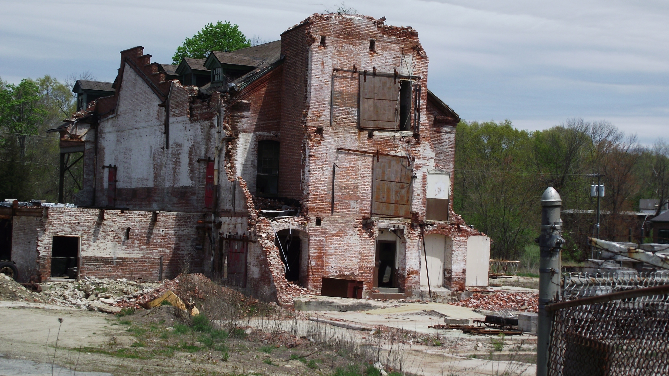
Preventing This,
and This…
…From Becoming This…
…Or This

Slide 6
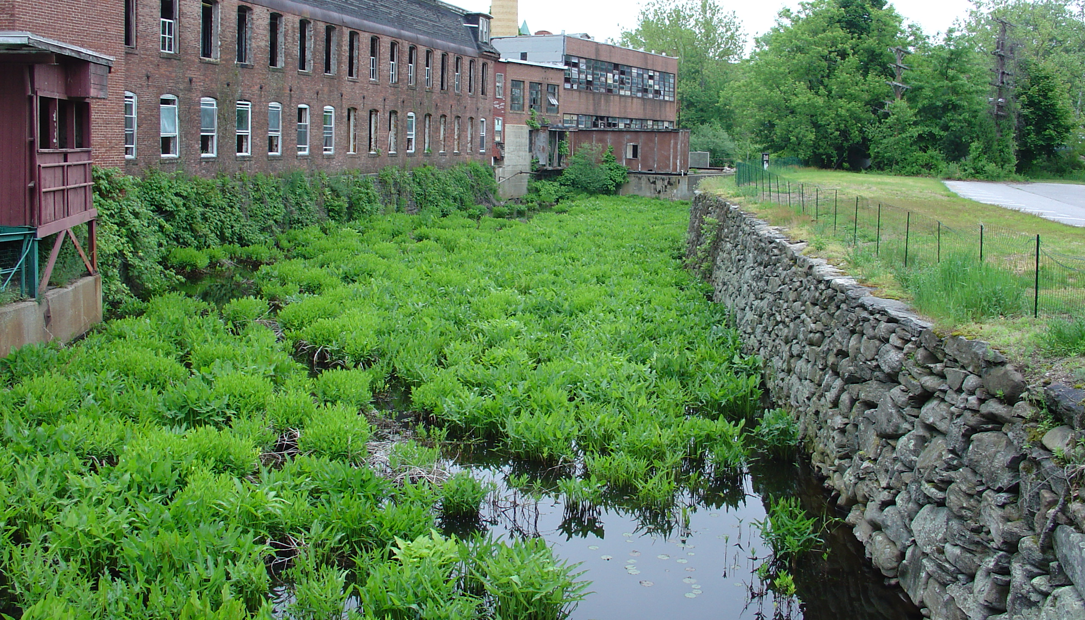
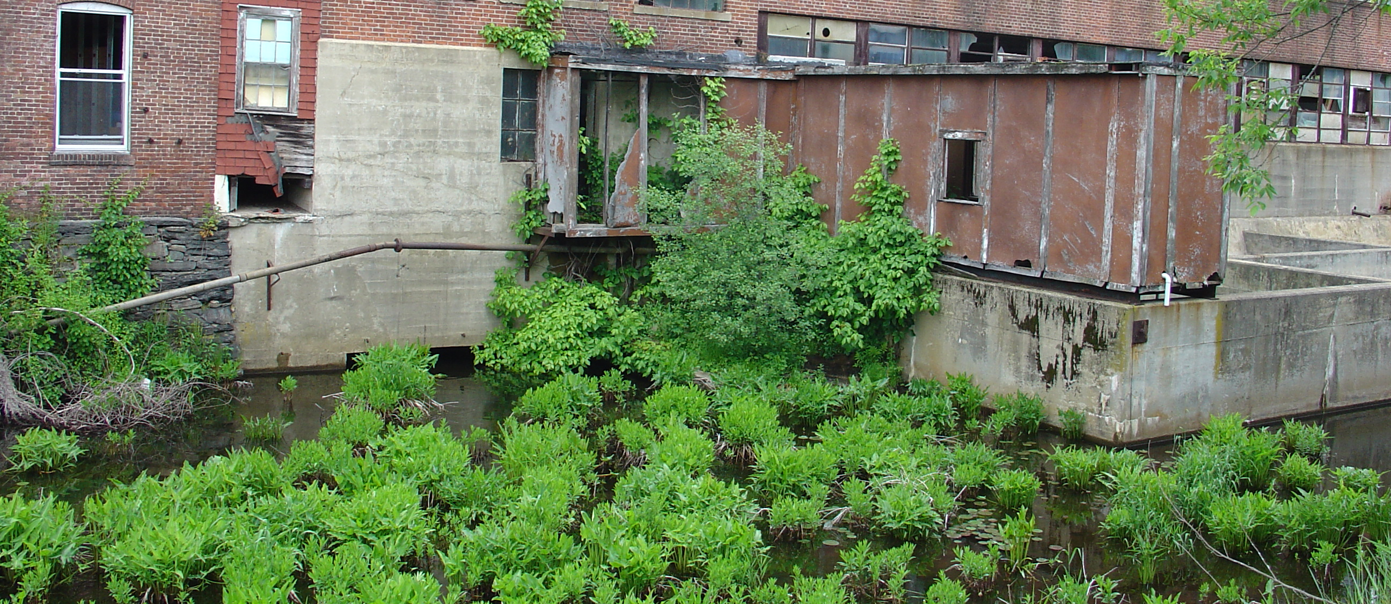
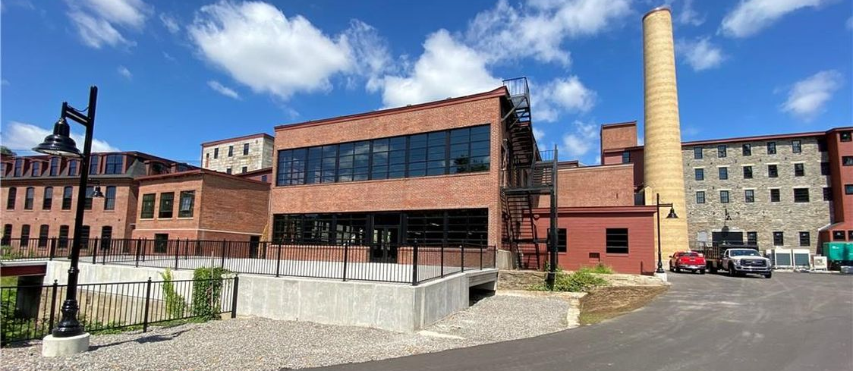

Slide 7
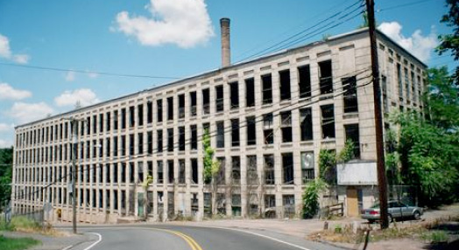
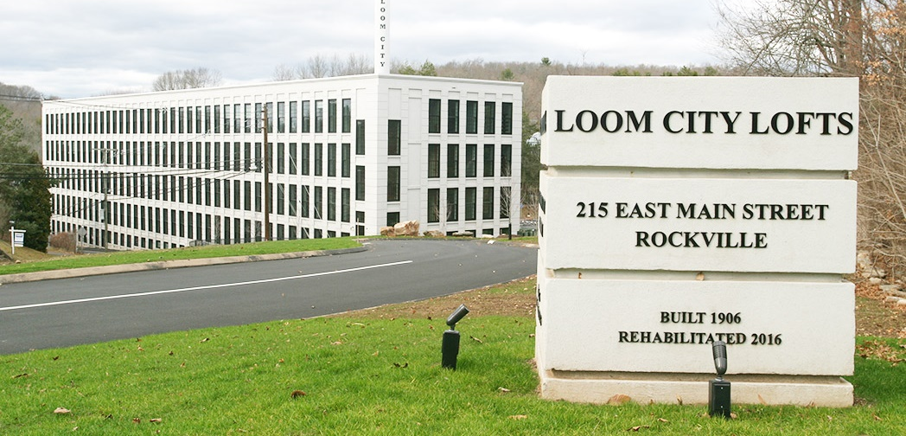
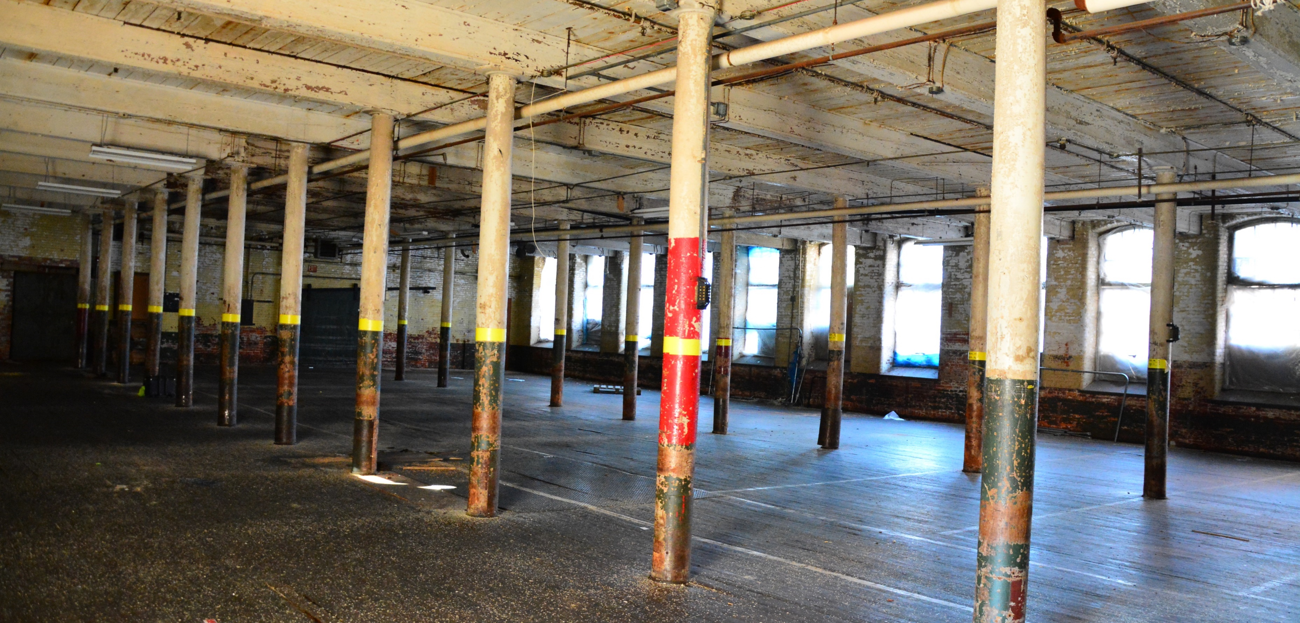

Slide 8
How ECLB Helps: “The Brownfield Land Bank Toolbox”
Work with municipal governments to understand brownfield problems in each town and plot a course to solve these problems
Obtain and administer brownfield grants
Conduct site assessments and remediation planning, structural analyses, historic preservation surveys, etc.
Allow towns to avoid taking title to brownfield sites
Acquire, retain, secure, remediate, and sell brownfields for the benefit of municipalities
Educate government officials, community leaders, economic development agencies and nonprofit organizations on best practices for redeveloping brownfields
Serve as liaison between the towns and the public, regulatory authorities, developers and others
Perform market analysis and redevelopment planning
Clear property titles, resolve orders, and liens
Enter brownfield sites into liability relief programs and secure transferable covenants not-to-sue from regulatory agencies
Conduct public outreach and facilitate stakeholder involvement
Market cleaned-up properties for sale and reuse
…AND ANYTHING ELSE TO ACCOMPLISH THE MISSION

Slide 9
Introduction to the Eastern Connecticut Land Bank, Inc.
A Connecticut corporation and certified non-profit entity under Section 501(c)(3) of the Internal Revenue Code
Certified by DECD as a “Connecticut Brownfield Land Bank”
Board of Directors consists of up to 11 members
Unique technical and managerial capacity and diversified sources of capital to tackle defunct and derelict properties
Grassroots organization serving communities of eastern Connecticut

Slide 10
ECLB Board of Directors: More Than 100 Years of Land Use, Engineering, Environmental Planning and Consulting Experience
Mary Ann Chinatti – President Town of Plainfield
Wayne Bugden, LEP – Vice President One Earth Environmental, LLC
Daniel Blanchette – Secretary J&D Civil Engineers, Inc.
Dennis Blanchette - Treasurer J&D Civil Engineers, Inc.
Richard Roberts, Esq. Legal Counsel Halloran & Sage, LLP
Tyra Penn - Town of Thompson
Cathy Tendrich - Town of Plainfield
Delpha Very - Town of Putnam
Tim Myjak, LEP - BL Companies, Inc.
Renee Tribert - Preservation CT
Tom Sinkewicz - Town of Plainfield

Slide 11
ECLB’s Ongoing and Recent Projects
$200,000 Brownfield Assessment Grant for Kaman mills area in Moosup Section of Plainfield
Assisted Stonington in $139,000 Brownfield Assessment Grant for Stillmanville Mill, and a Brownfield Cleanup grant in Mystic
Working to help Montville, E. Windsor, and Stonington with their most difficult brownfield sites; Recent discussions with Putnam, Thompson, Killingly, and Windham about their brownfield sites
Looking forward to helping your community with its brownfields

Slide 12
Now is the Ideal Time to Tackle Brownfields
State of Connecticut has been making huge investments in Brownfield grants and loans
Federal Infrastructure Bill includes $1.5 Billion in Brownfield funding
Better Laws like the Brownfield Landbank Legislation and Liability Relief Programs
Complementary programs like Opportunity Zones and Enterprise Zones aid feasibility
Improved, more “user-friendly” environmental regulations facilitate cleanup and reduce costs

Slide 13
How Will ECLB Help Your Town? ECLB’s staff and volunteers will be available to:
Assist with ongoing projects
Write and Administer Grants
Participate in public outreach, strategic meetings
Work to market sites and leverage private funds
Education/Liaison with public, state & federal agencies, developers/investors
Possible acquisition, cleanup, and resale of brownfield sites

Slide 14
Despite Our Abilities and Recent Successes, ECLB Faces Challenges
Brownfield assessment, remediation and redevelopment is lengthy, complex and costly
All tasks require a lot of time and professional expertise
ECLB has no staff – all functions are currently accomplished by volunteers on our Board of Directors
We have no funds to hire staff, or pay for professional services or operating expenses

Slide 15
How Can Your Town Help ECLB? We are seeking financial assistance from Towns in our region to help fund:
Salary, benefits, and business expenses of a full-time Executive Director for ECLB
Legal services and other professional expenses; to date, ECLB’s general counsel has generously provided hundreds of hours of pro bono services.
Help with business administrative and clerical expenses, including website design and maintenance, domain fees, IT services, cloud storage, office equipment, and supplies

Slide 16
Helping ECLB Will Also Show Town’s Commitment to Brownfield Redevelopment, Which Will:
Improve
Relations with DEEP, DECD, EPA, etc.
Increase
Chances for obtaining more state and federal grants
Attract
Businesses and investment

Slide 17
Thank You! Questions?

